Slide 1
What is that Dark Spot?
A deeper look into Cavities…
By: Rachel Morsette, DA

Slide 2
What does a cavity look like?

Slide 3
How can my cavities be fixed?

Slide 4
Amalgam Fillings
The technical term for “silver” fillings are called either Amalgam or Alloy restorations. Amalgam fillings are known for their longevity and durability.

Slide 5
Composite Fillings
The technical term for “tooth colored” fillings are called Composite Restorations. They are known for their natural appearance and bonding capabilities.

Slide 6
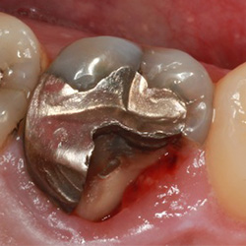
What is a crown?
A crown is like a “hat” for a tooth. Crowns act like a belt around the tooth, holding it all together. It is generally done when a tooth has either too much filling material or fractures that require support.

Slide 7
Why does my tooth hurt?
When a cavity is not addressed early, it will grow large enough to expose the inside of the tooth. As it increases in size, the cavity will extend to the nerve of the tooth. Generally, when the nerve is involved patients will experience a “tooth ache”.

Slide 8
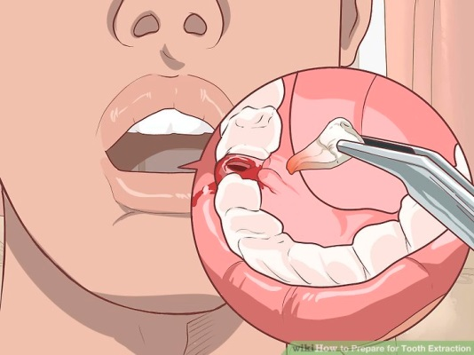
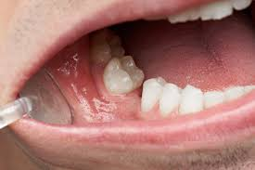
Is my tooth beyond repair?
Root Canal
Extraction

Slide 9
What can I do to avoid cavities?
Brush and floss daily
Routine check ups
Eat or drink acidic or sugary foods in moderation
Used fluoridated dental products

Slide 10
QUESTIONS?

