Slide 1
Oral Cancer
signs, symptoms, and reducing our risk
By: Sally Wiedeman, EPDH, MBA

Slide 2
The end of this presentation contains some graphic images

Slide 3
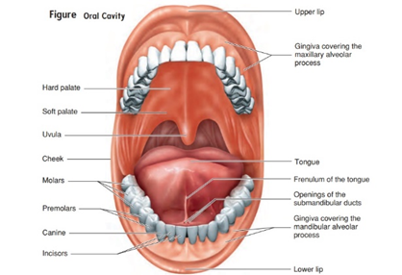
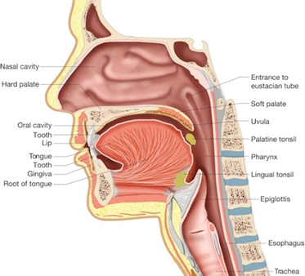
Where does it affect us?
Oral cavity or mouth
Oropharynx or throat & neck

Slide 4
WHAT ARE THE MOST COMMON TYPES OF ORAL CANCER?

Slide 5
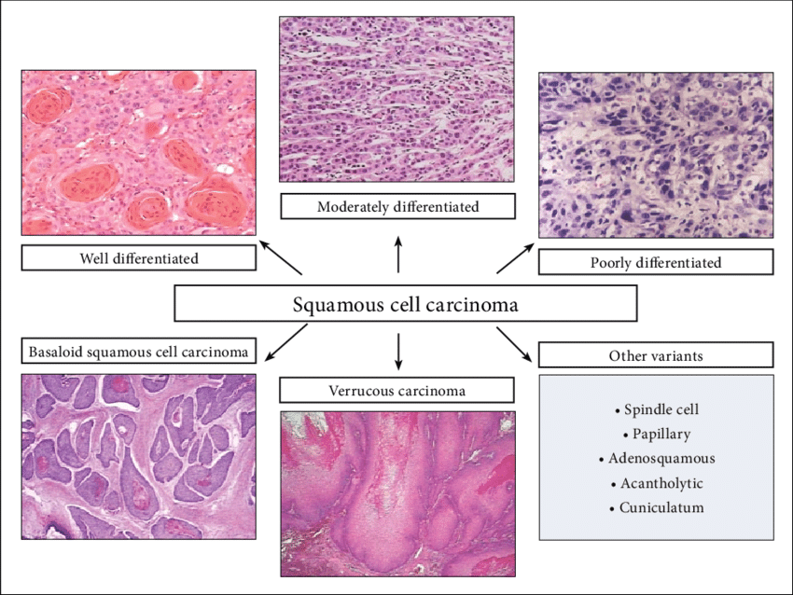
Types
Squamous Cell Carcinoma
90% of oral cancer
Develop more often on tonsils and tongue
Grow undetected (without symptoms) and quickly
Verrucous Carcinoma
5% of oral cancer
Slow growing
Made up of squamous cells
Rarely spreads to other parts of the body but can invade nearby tissue

Slide 6
Types
Minor Salivary Gland Carcinoma
Form on minor salivary glands
Located throughout the lining of the mouth and throat
Lymphoma
Develop in the lymph tissue (part of the immune system)
Tonsil and base of the tongue both contain lymphoid tissue
Human Papilloma Virus-HPV
More common in the throat, but can develop on lips and cheeks

Slide 7
WHAT ARE THE SIGNS OF ORAL CANCER?

Slide 8
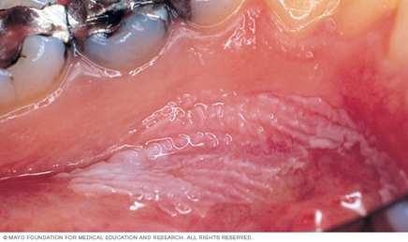
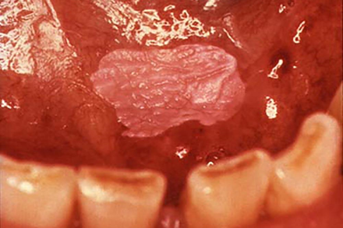
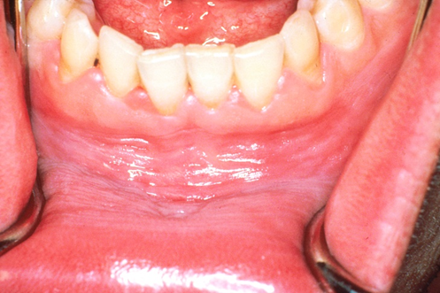
Signs
Leukoplakia-white patch
Less likely to become cancerous-25% chance

Slide 9
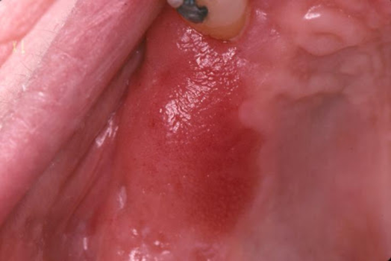
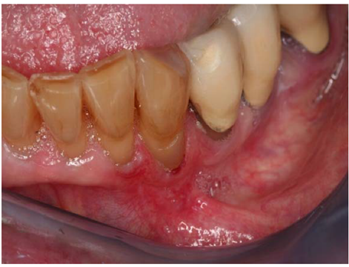
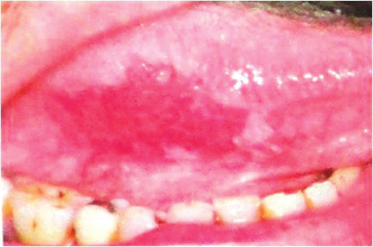
Signs
Erythroplakia-red patch
Greater risk of become cancerous-70% chance
Red with white borders

Slide 10
WHAT ARE THE SYPTOMS OF ORAL CANCER?

Slide 11
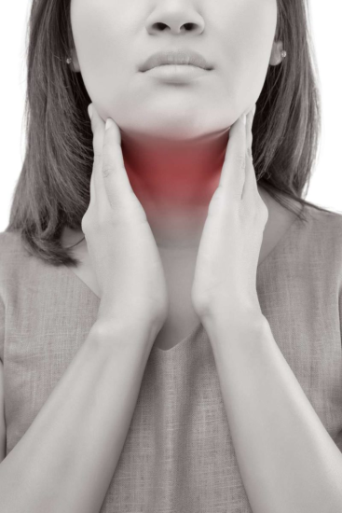
Symptoms
Lump or thickening in the oral soft tissues
Soreness or a feeling that something is caught in the throat
Difficulty chewing or swallowing
Ear pain
Difficulty moving the jaw or tongue
Hoarseness
Numbness of the tongue or other areas of the mouth
Swelling of the jaw
Mass in the neck

Slide 12
WHAT INCREASES OUR RISK OF ORAL CANCER?

Slide 13
Genetic Risk Factors
Gender
Men are 2 times higher risk than women
Age
2/3rd of the patients with oral cancer are age 55 or older
Average age when oral cancer is diagnosed is 62
Can be found in younger people
Genetic syndromes
Fanconi anemia is a blood condition caused by inherited abnormalities in several genes
The risk of oral cancer is up to 500 times higher than the general population
Dyskeratosis congenita is a genetically linked syndrome that may cause aplastic anemia
Carries a high risk of oral cancer beginning at an early age

Slide 14
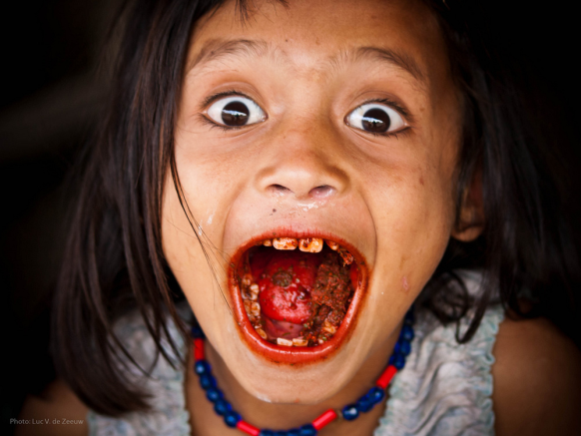
Non-Genetic Risk Factors
Tobacco
Alcohol
Marijuana
Betel Nut
Poor nutrition
Exposure to sunlight or ultraviolet light
Immune system suppression drugs

Slide 15
CAN ORAL CANCER BE TREATED?

Slide 16
What can we do?
Do routine self exams at home
Any sore that last more than 2 weeks and/or changes color, size, shape have examined by dentist or primary care doctor
Yearly exam with a dentist where an oral cancer screening is performed
Stop chewing, drinking alcohol, smoking tobacco or marijuana
Get vaccinated for HPV
Safe for ages 9-45 years old
Avoid tanning beds
Use chapstick that contains sunscreen

Slide 17
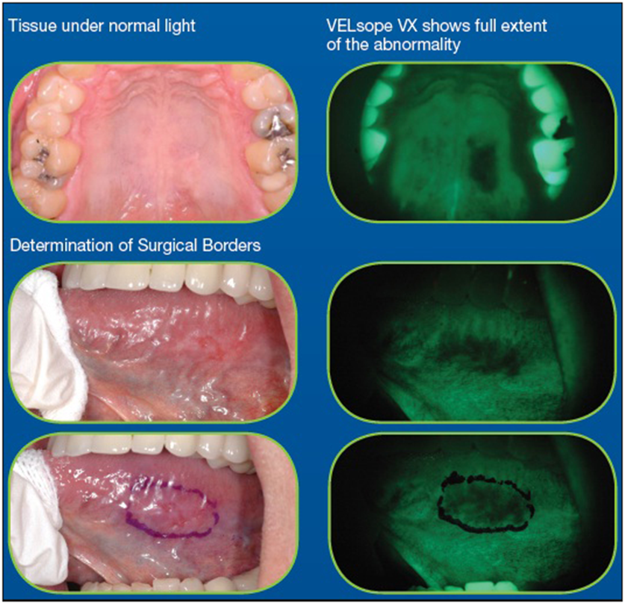
Oral Cancer Screening by Dentist or Self
Oral Cancer Screening Device

Slide 18
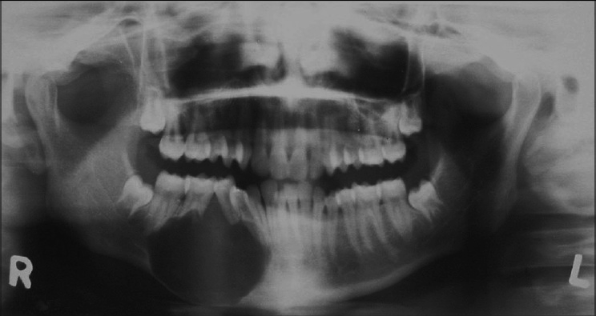
Treatment
Diagnostic
Performed Procedures
Biopsy
MRI
PET scan
X-rays
Surgical removal
Radiation
Chemotherapy
Usually paired with Radiation
Target drug therapy
Works by interfering with cancer cell growth on a molecular level
Paired with Radiation or Chemotherapy
Immunotherapy
These drugs work by helping the body's immune system identify and kill cancer cells

Slide 19
Picture Time

Slide 20
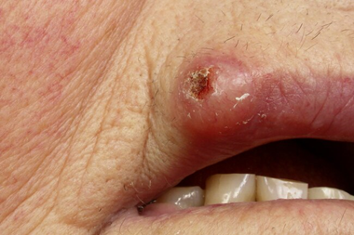
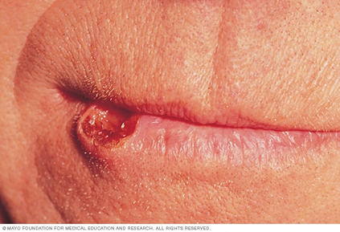
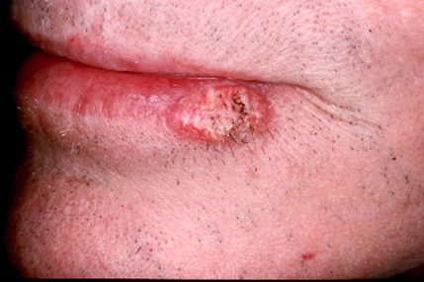
Lips
Most common type of cancer
Men have a higher rate of lip cancer

Slide 21
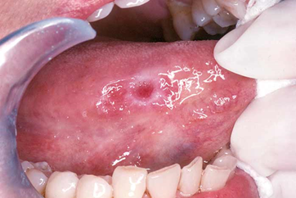
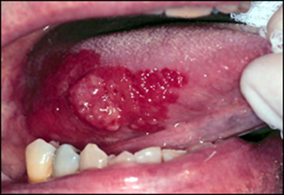
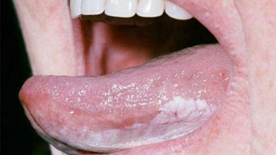
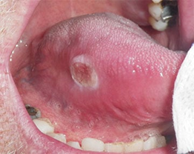
Tongue
Appears on front 2/3rd of the tongue
If present on back 1/3rd of tongue it is classified as oropharyngeal/neck cancer

Slide 22
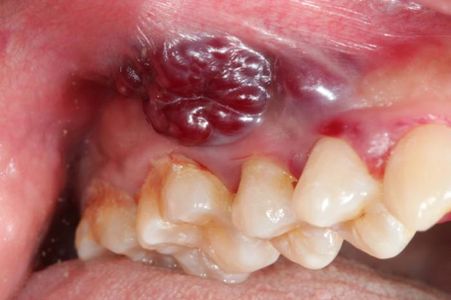
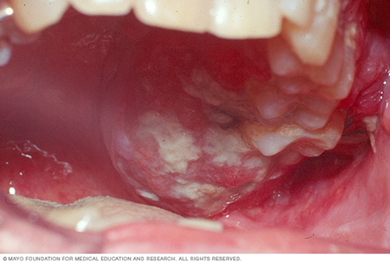
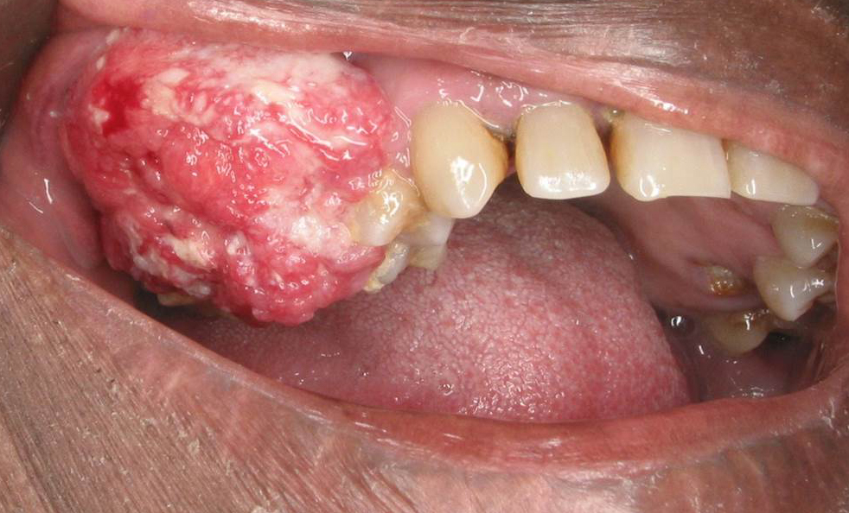
Hard and Soft Tissue

Slide 23
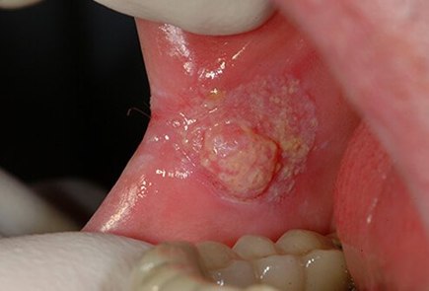
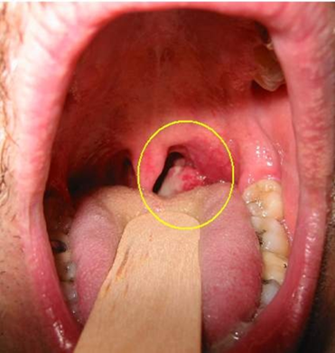
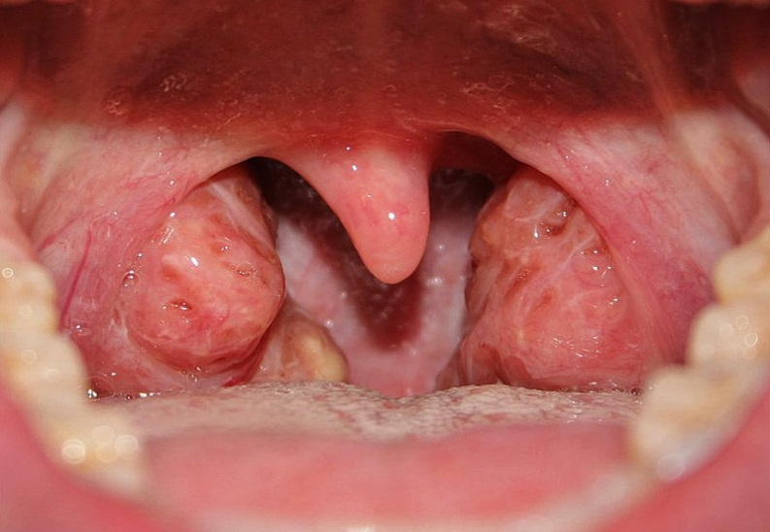
Human Papilloma Virus-HPV

Slide 24
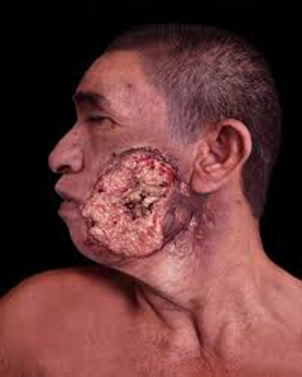
Tobacco Related

Slide 25
Questions?

