Slide 1
Tobacco and Oral Health
By: Rachel Morsette, DA & Jourdan Burklund, EPDH

Slide 2
Topics
What makes tobacco products harmful?
What oral conditions can be caused by tobacco products?
What can you do to help prevent serious issues caused by tobacco products?

Slide 3
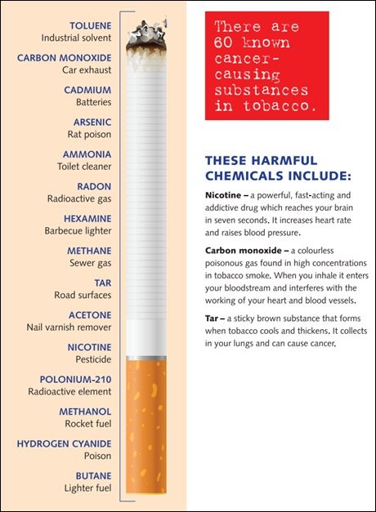
Carcinogens
Definition:
A substance capable of causing cancer in living tissue.

Slide 4
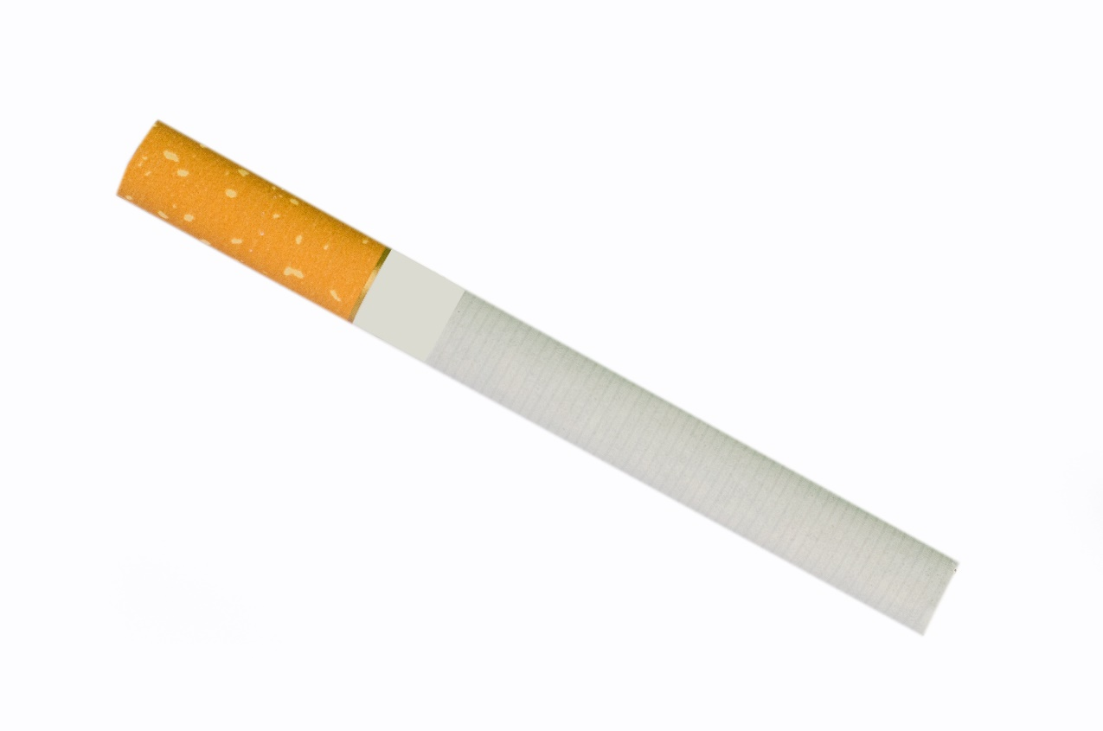
Cigarettes
Up to 3000 different substances are inhaled in one drag of a cigarette
At least 50 are carcinogens or pro-carcinogens
Cigarette smoke is acidic (mouth likes to be basic)
Most of the nicotine is absorbed through oral mucosa

Slide 5
Vaping
Electronic cigarettes
Do not contain tobacco
Nicotine is dissolved in propylene glycol and/or glycerin

Slide 6
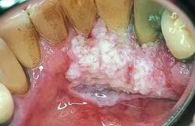
Smokeless Tobacco?
Almost half of all spit tobacco users have oral mucosal lesions and gingival recession
Can lead to the same cancers caused by smoking
Lesions are typically white, hard, and wrinkly
Also can lead to verrucous carcinoma

Slide 7
What’s in Chewing Tobacco?
Polonium 210 (nuclear waste)
Formaldehyde (embalming fluid)
Cadmium (used in car batteries)
Lead (nerve poison)
Nitrosamines (cancer causing substances)
Arsenic (causes cancer in the skin, lungs, bladder and kidneys)
Cyanide (if ingested can cause death)

Slide 8
What makes tobacco harmful?
Promotes excess cell growth, leading to cancer
Inhibits/delays healing
Weakens immune system
Dental treatments are less effective
Gum disease tends to progress more rapidly
Gums tend to be more fibrotic with little redness, masking gingivitis

Slide 9
Non-Neoplastic Conditions
Leukoedema
Nicotinic Stomatitis
Smoker’s Melanosis
Mouth and throat irritation
Halitosis
Xerostomia (dry mouth)
Staining
Tooth loss
Chronic Periodontitis
Increased rate/severity of bone loss

Slide 10
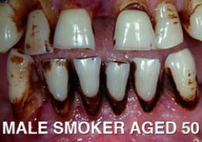
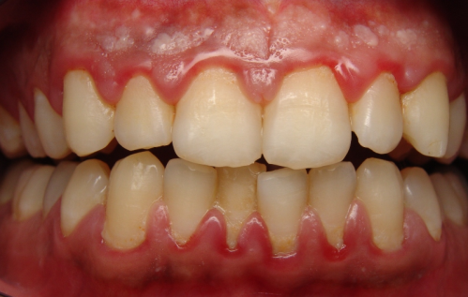
Calculus
Staining
Primarily cosmetic
“Tartar”
Can contribute to gum disease
Plaque-Induced Gingivitis
Inflammation of the gums
Reversible form of gum disease
Can lead to periodontitis

Slide 11
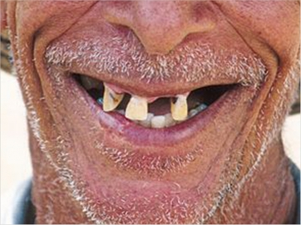
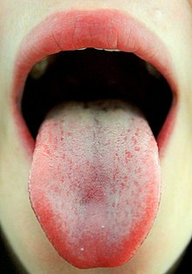
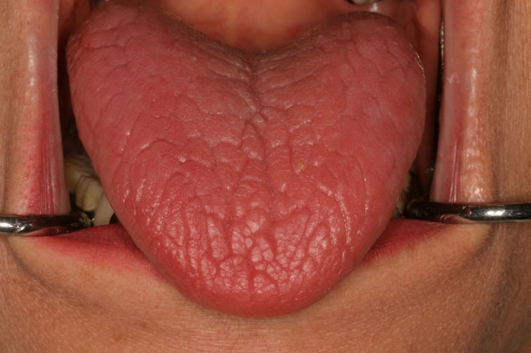
Halitosis
Tooth Loss
Heavy smokers are at 3-fold greater risk of tooth loss compared to non-smokers
Present in 80% of people who smoke
Xerostomia
“Dry mouth”
Can lead to rampant caries

Slide 12
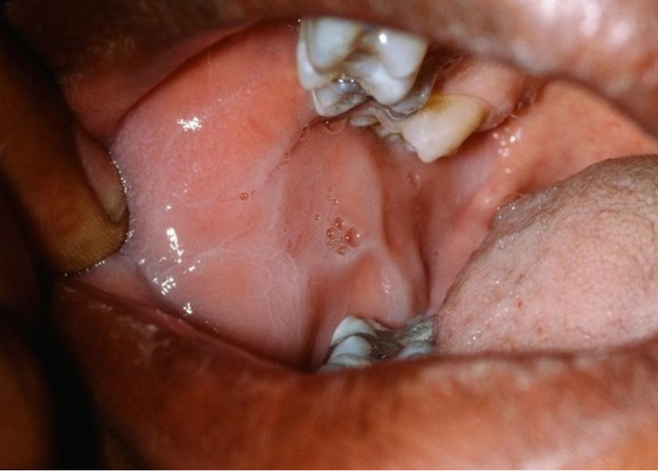
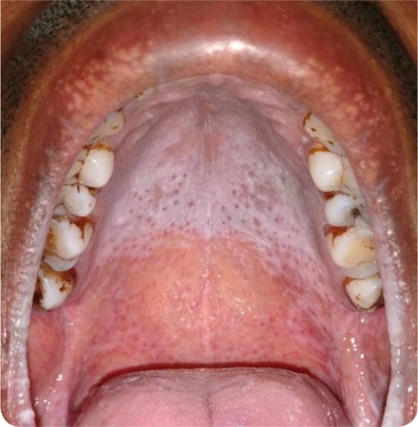
Leukoedema
Excess fluid in tissue
Opalescent appearance
Nicotinic Stomatitis
Keratinized (white) palate
Red, raised dots (inflamed minor salivary glands)

Slide 13
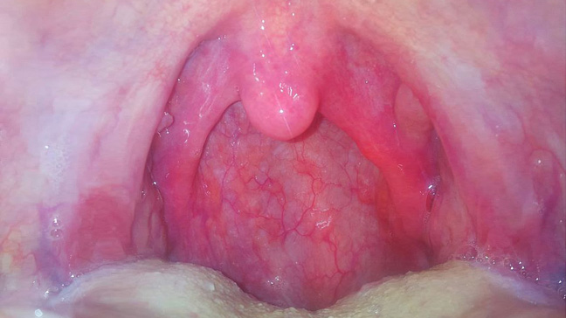
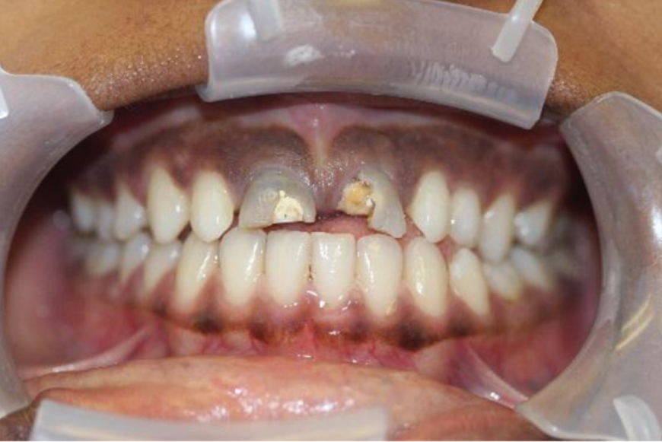
Mouth and Throat Irritation
Usually due to the heat of the smoke inhaled
Smoker’s Melanosis
Excessive melanin pigmentation proportional to amount of smoking
Can fade back to normal after smoking ceases
May take months or years

Slide 14
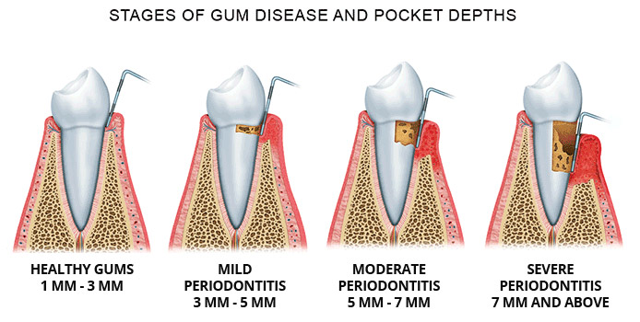
Periodontitis
Irreversible form of periodontal disease (aka “gum disease”)
Breakdown of structure surrounding tooth

Slide 15
Periodontitis
Twice the risk of gum disease compared to non-smoker
The more cigarettes you smoke, and the longer you smoke, the greater the risk for gum disease
Treatments for gum disease may not work as well for people who smoke

Slide 16
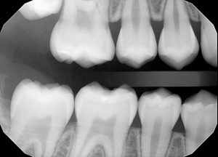
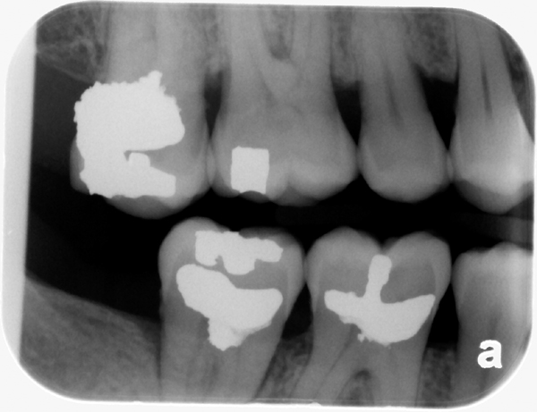
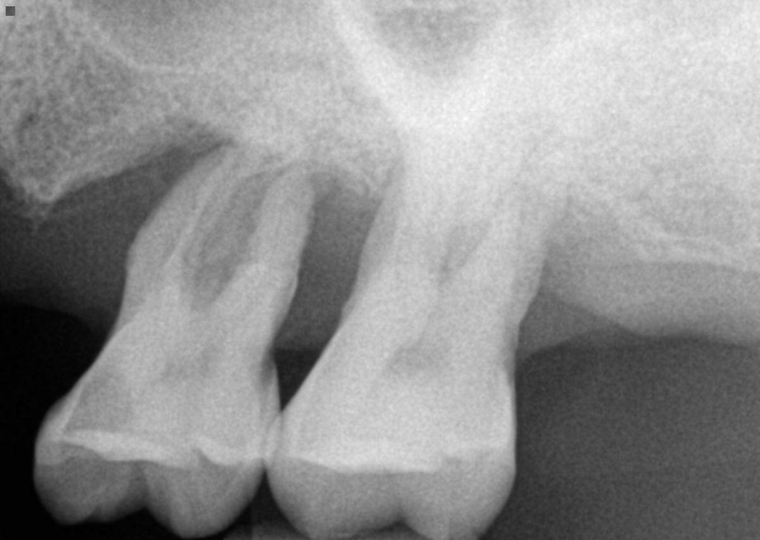
Periodontitis
No bone loss
Moderate bone loss
Severe bone loss

Slide 17
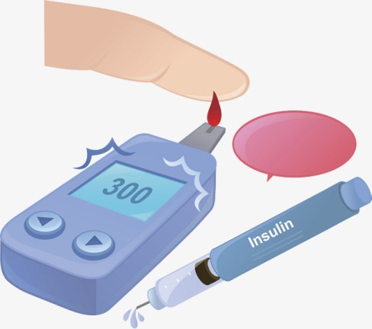
Link between Diabetes, Tobacco use and Periodontal Disease

Slide 18
Link to Diabetes Type 2
Tobacco use can increase the blood sugar levels and lead to insulin resistance
Smokers are 30-40% more likely to develop type 2 diabetes than non-smokers
People who smoke and are diabetic have a more difficult time controlling their insulin levels than non-smokers
Uncontrolled diabetes is linked to periodontitis, and vice versa

Slide 19
Pre-Malignant Conditions
Leukoplakia
Erythroplakia
Lichen Planus

Slide 20
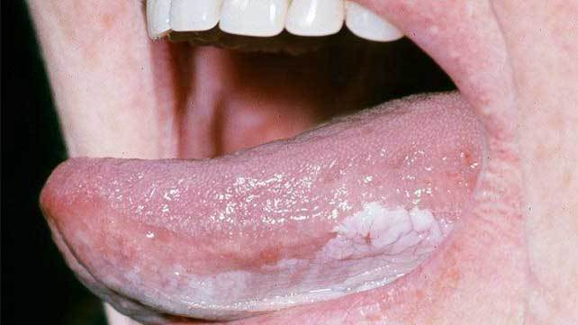
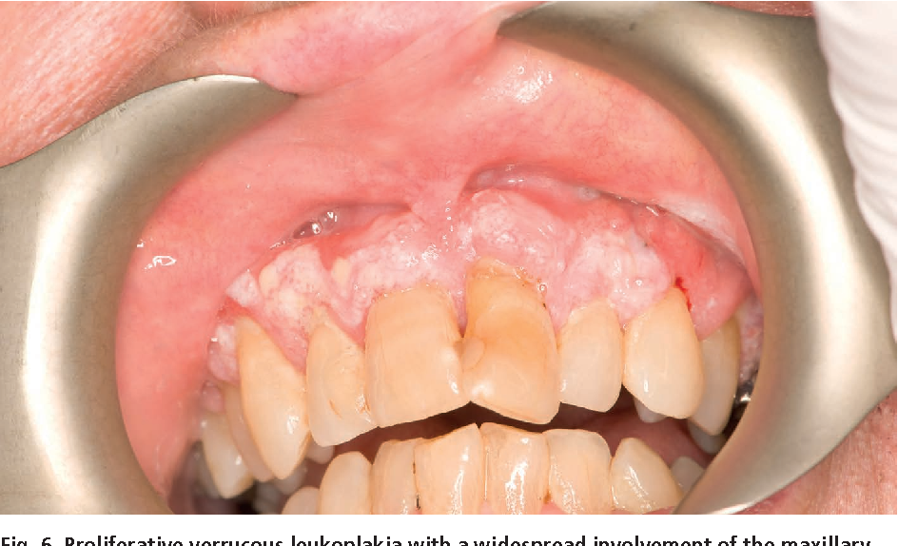
Leukoplakia
“White Lesion”
It has a malignancy conversion rate ranging from 0.1% to 17.5%

Slide 21
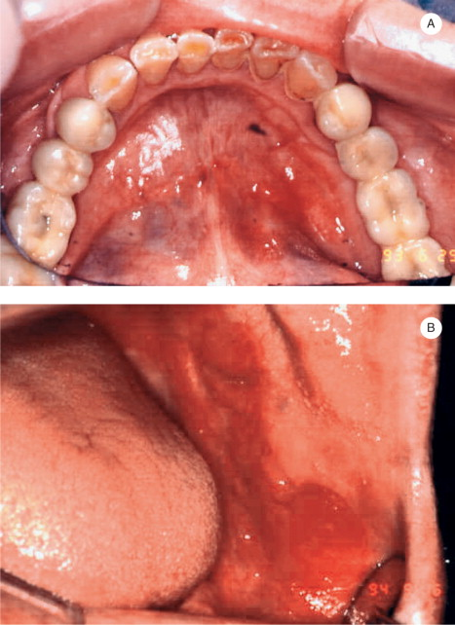
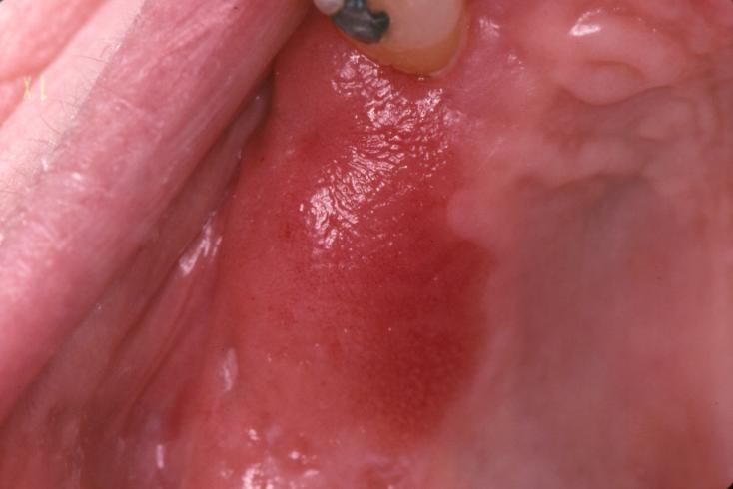
Erythroplakia
“Red Lesion”
Smooth, red, velvety
Uncommon, but 90% exhibit epithelial dysplasia or squamous cell carcinoma

Slide 22
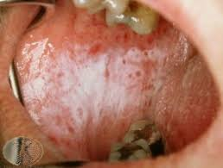
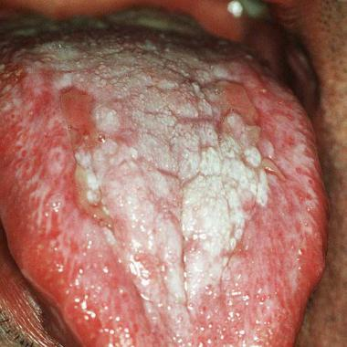
Lichen Planus
White striations on buccal mucosa
Premalignant epithelial dysplasia can look like lichen planus, so a biopsy should be performed to check

Slide 23
Neoplastic Conditions
Squamous Cell Carcinoma
Aka Epidermoid Carcinoma

Slide 24
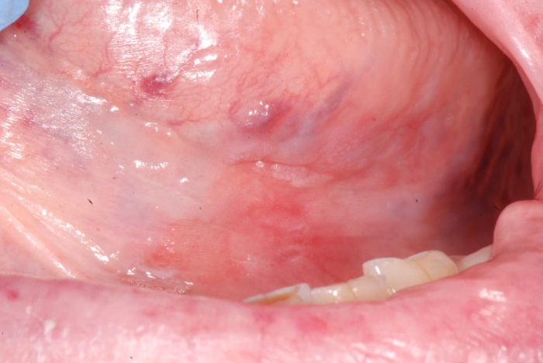
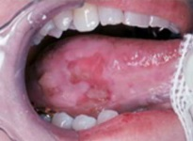
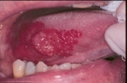
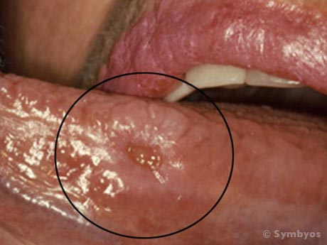
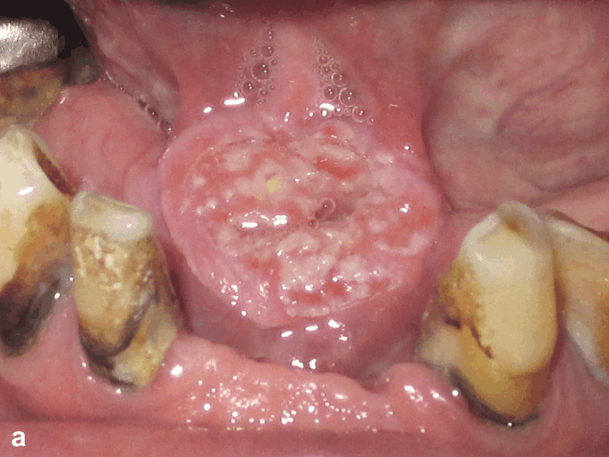
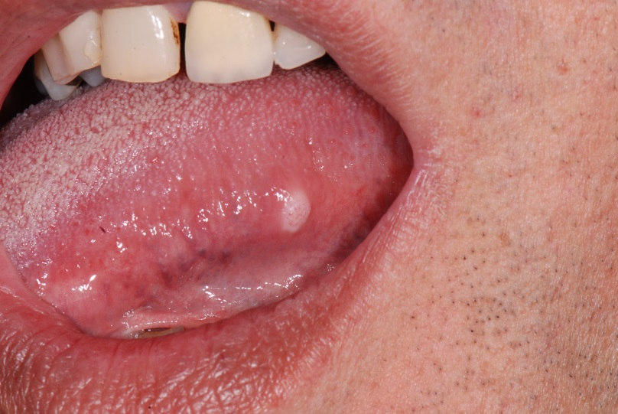
Squamous Cell Carcinoma
Usually on floor of mouth or on tongue
Physical characteristics are extremely variable
Can look anywhere from flat and pebbly to a large, ulcerated, indurated mass

Slide 25
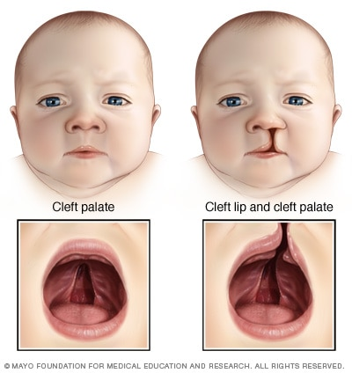
Tobacco and Pregnancy
Smoking while pregnant can lead to:
Miscarriage
Low birth weight
Cleft lip/palate
Delayed tooth formation

Slide 26
What can you do?
Oral cancer screenings
Regular, appropriate dental visits
Good home care habits

Slide 27
Oral Cancer Screening
Look for abnormalities regularly
Asymmetry
Tongue, floor of the mouth
If a sore/lesion does not heal within 2 weeks, get it checked out

Slide 28
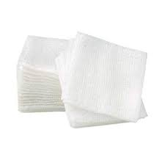
Oral Cancer Screening
Use a large mirror and good light source
Flashlight, mouth-sized mirror, gauze/tissue

Slide 29
Oral Cancer Screening
Face and neck:
Symmetry: check for one-sided irregularities
Skin: check for sores, bumps, and discolorations
Neck: palpate lymph nodes for lumps or tender areas

Slide 30
Oral Cancer Screening
Lips and Gums
Retract lips: look for sores or color changes
Palpate lips: run finger over gums to feel for irregularities, tenderness, or roughened areas

Slide 31
Oral Cancer Screening
Cheek:
Retract right, then left side. Look for red, white, brown, or speckled patches
Feel for lumps or tenderness
Run a finger over inside surface of cheek to check for rough or raised areas

Slide 32
Oral Cancer Screening
Roof of Mouth:
Tilt head back and use flashlight and mouth mirror
Look for sores or color changes
Feel for lumps or areas of tenderness

Slide 33
Oral Cancer Screening
Tongue:
Extend tongue, check top of tongue
Use gauze/tissue to grasp tongue and pull tongue to left and right sides
Check for sores, color changes, and irregularities

Slide 34
Oral Cancer Screening
Floor of Mouth:
Put tip of tongue against roof of mouth
Look for asymmetry, sores, or color changes
Place fingers of one hand under jaw, then place fingers of other hand on floor of mouth to compress structures
Check for lump, tenderness, or irregularities

Slide 35
Dental Visits
Regular dental visits are important to monitor oral health through visual exams and x-rays
Scaling and Root Planing may be necessary to encourage oral health
Regular maintenance/cleaning appointments are important to maintain the overall health of the mouth

Slide 36
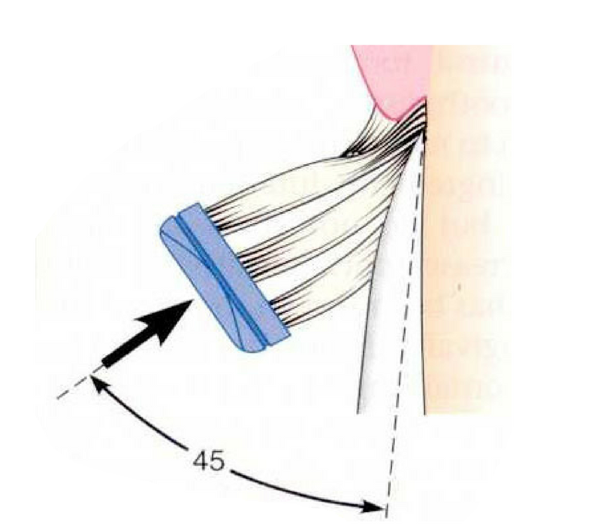
Home Care
Brush teeth 2x a day (morning and night)
Aim bristles toward gumline
Floss 1x day
Use appropriate interproximal aid
Avoid mouthwashes containing alcohol
Can contribute to dry mouth

Slide 37
Questions?

