Slide 1

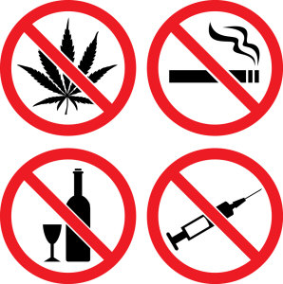
Effects of Drugs on our Mouth
By Sally Wiedeman, EPDH, MBA

Slide 2
Common Affects
Poor Oral Hygiene
Dry mouth
Acid reflux
Grinding of teeth/clinching of jaw
Decay/Cavities
Gum disease
Ulcers/sores
Staining

Slide 3
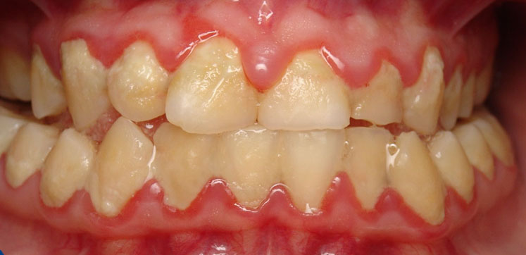
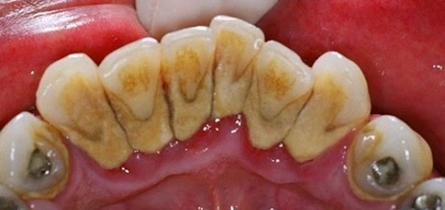
Poor Oral Hygiene
PLAQUE
CALCULUS/TARTAR

Slide 4
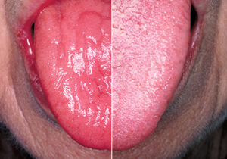
Dry Mouth
Reduced salivary flow
  Dries out the cheeks, tongue and lips
  Increases risk for cavities

Slide 5
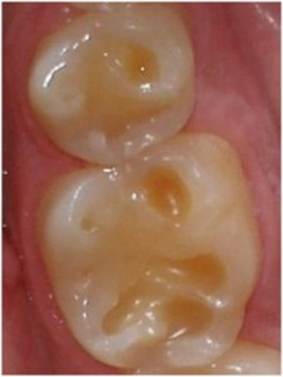
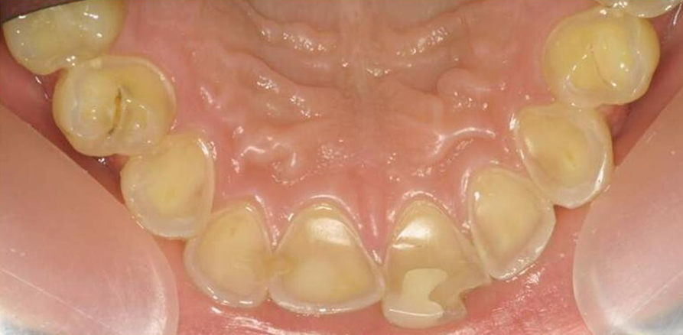
Acid Reflux
Most drugs are acidic
  Breaks down the enamel on our teeth- irreversible
    Can lead to cavities
    Weaken tooth structure

Slide 6
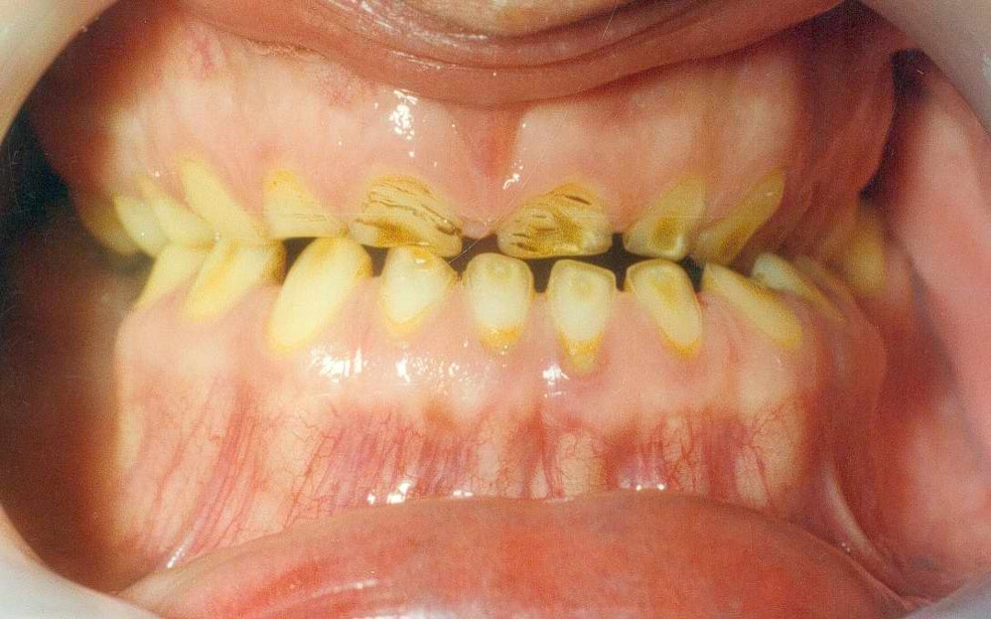
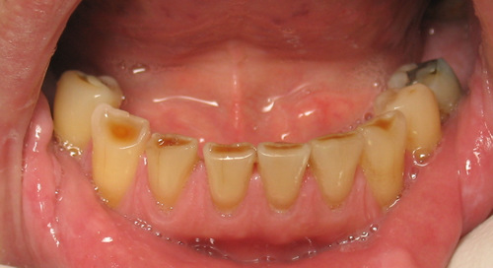
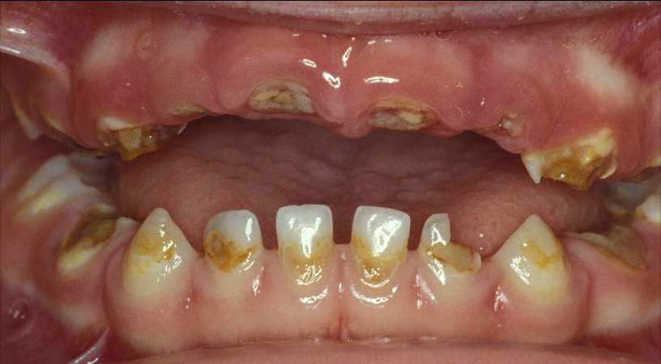
Grinding/Clinching

Slide 7
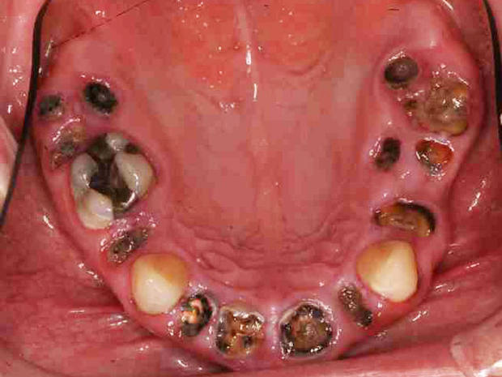
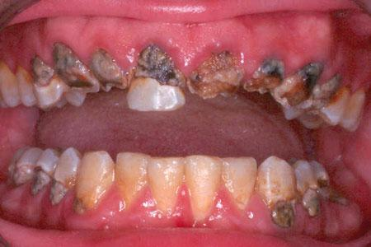
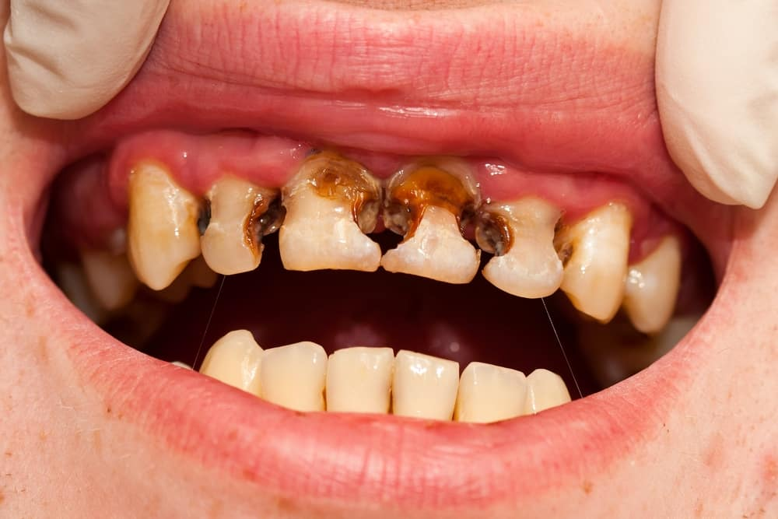
Decay/Cavities

Slide 8
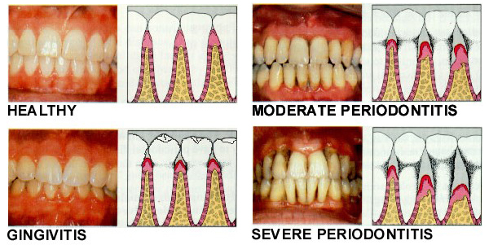
Gum Disease

Slide 9
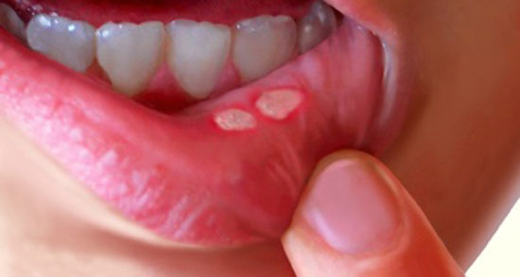
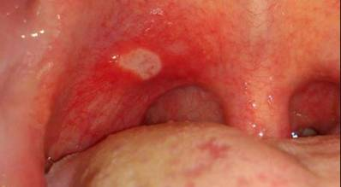
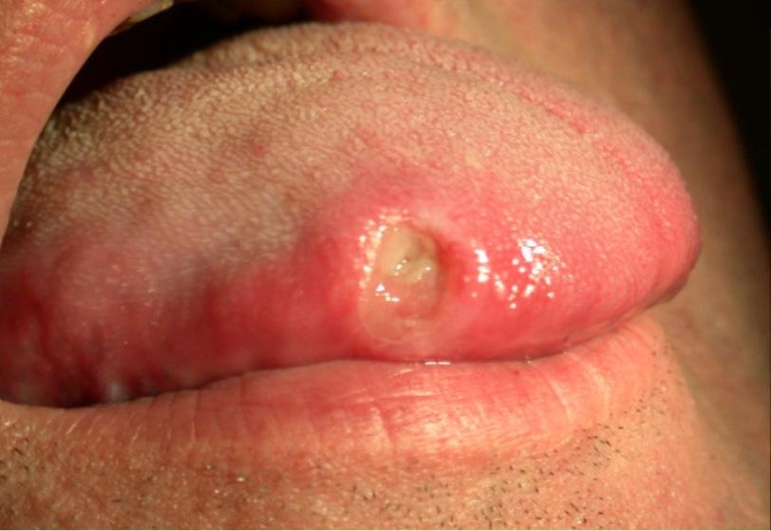
Ulcers/Sores

Slide 10
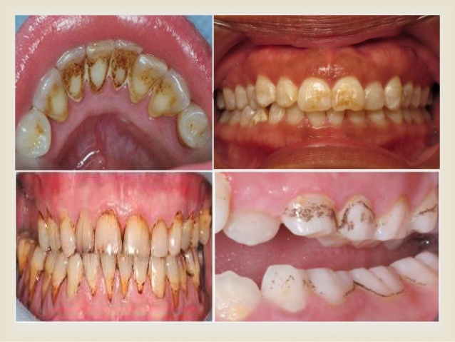
Staining

Slide 11


