Slide 1

Filling in the Gaps
Replacing Missing Teeth
BY: RACHEL MORSETTE, DA

Slide 2
It is estimated that 178 million Americans are missing at least one tooth and about 40 million Americans are missing all of their teeth. As we age, the problem gets worse as 30 percent of adults between 65-74 years old have no natural teeth.
American College of Prosthodontists
The main cause of tooth loss:
Periodontal Disease
Decay
Trauma

Slide 3
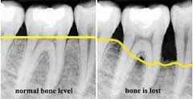
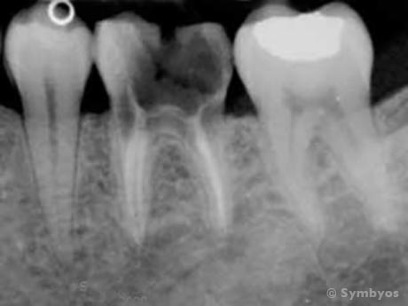
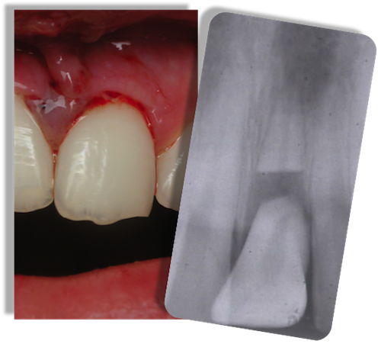
Periodontal Disease
Decay
Trauma

Slide 4
Do you have to replace missing teeth?
Your teeth are designed to work together to help you chew, speak and smile. Losing one or more can affect all of these things. Chewing can become difficult and painful. Having gaps can affect the way your tongue moves in your mouth, altering speech. Smiling without teeth can become uncomfortable for most which plays a huge toll on confidence.
Options for tooth replacement:
Bridges
Partials and Full Dentures
Implants

Slide 5
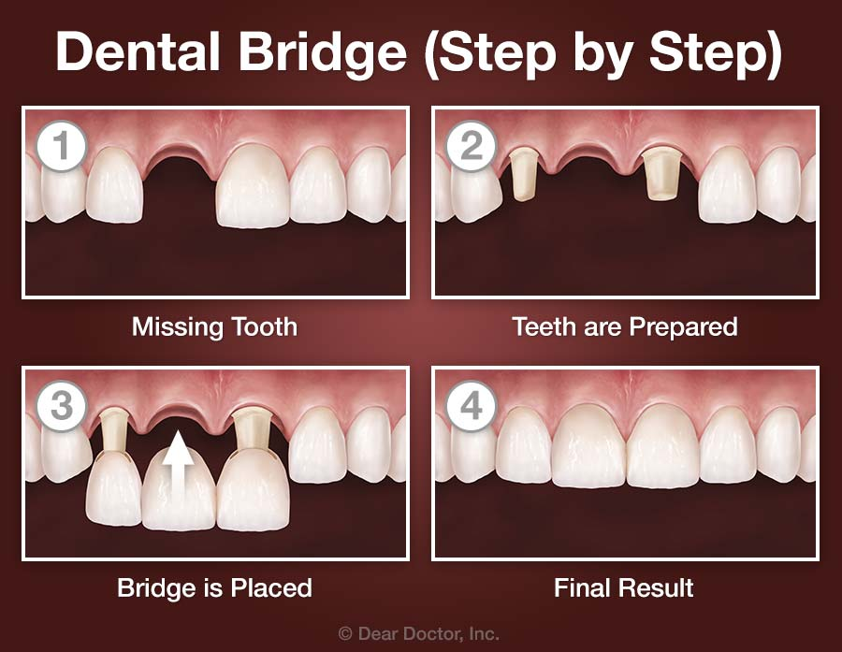
Bridges
Fixed appliance that is permanently cemented onto prepared adjacent teeth.
Pro’s- is a non-removable appliance
Con’s- healthy tooth structure has to be removed on adjacent teeth

Slide 6
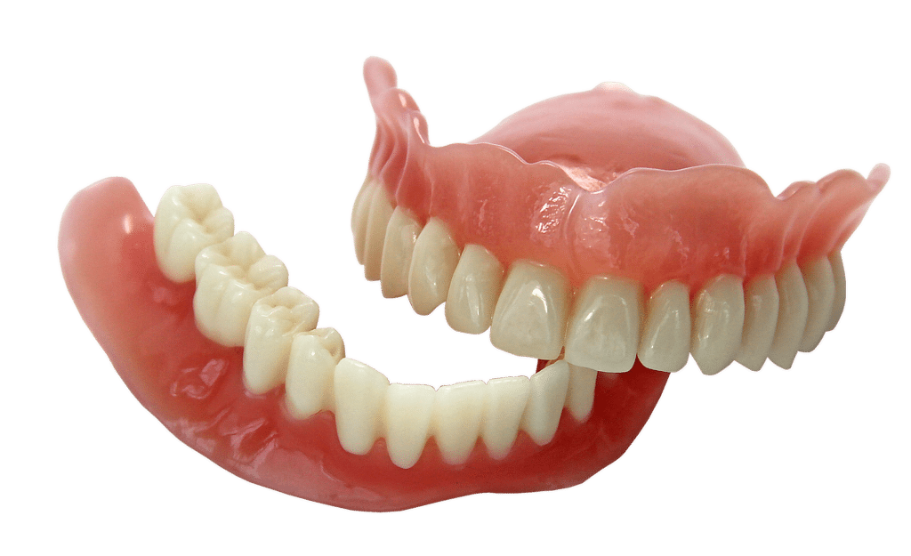
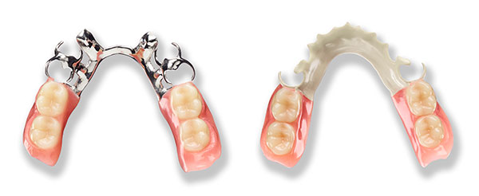
Partials and Full Dentures
Partial Denture
Full Denture
Dentures are removable appliances that hold artificial teeth. They replace missing teeth to aid when chewing and to help the overall appearance of someone’s smile.
Pro’s- affordable option in tooth replacement
Con’s- decreased ability to taste food, may shift around and be uncomfortable

Slide 7
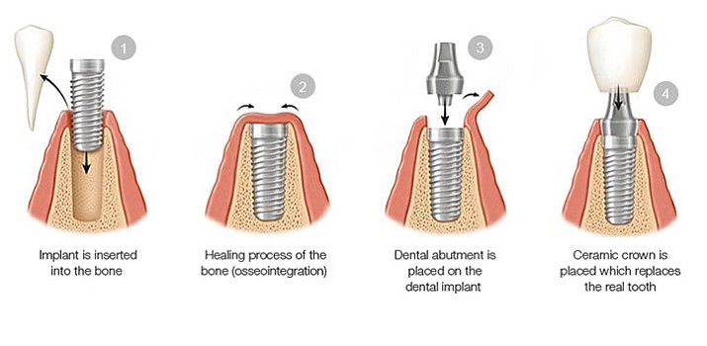
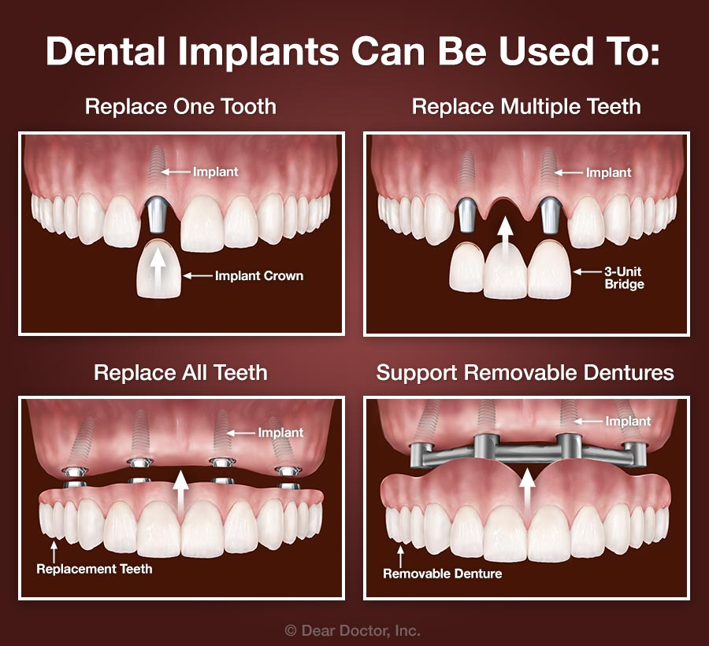
Dental Implants
A dental implant is a titanium post that is surgically placed into bone in the mouth. Implants can be used to support a single tooth, multiple teeth or even a removable appliance.
Pro’s- the most “tooth like” replacement for missing teeth, a permanent appliance
Con’s- the most expensive option for tooth replacement

Slide 8
Having missing teeth can be overwhelming and upsetting. If you experience missing teeth, it is important to see your dental provider for regular checkups and maintain a healthy mouth.
Removable appliances can be a temporary fix until something more permanent or comfortable is attainable.
Keeping the remaining teeth healthy will affect your overall health in a positive way.

Slide 9
Questions?

