Slide 1
What Keeps our Mouth Healthy
By: Sally Wiedeman, EPDH, MBA

Slide 2
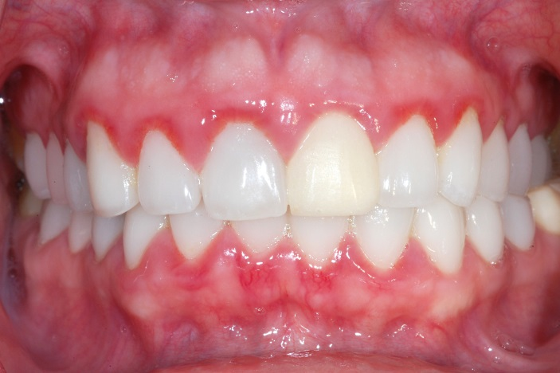
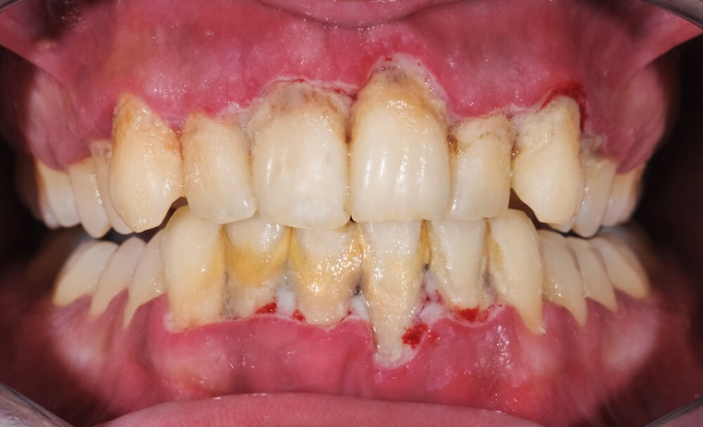
Healthy
Gingivitis
Gum Disease

Slide 3
Proper Oral Hygiene at Home
Brushing 2 times day for 2 minutes
Using fluoridated toothpaste
Cleaning between our teeth once a day
Floss
Proxy brush
Toothpicks
Waterpik
Mouth wash with Fluoride

Slide 4
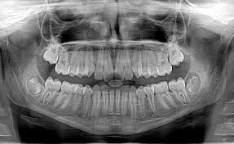
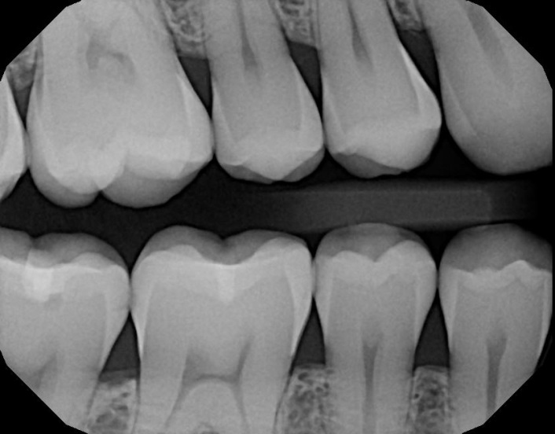
Dental Clinic Visits
Routine dental cleanings
1-4 times a year
Fluoride Applications
1-4 times a year
Exam and X-rays

Slide 5
Nutrition
Water
Milk
Vitamins/Minerals
Fruits
Vegetables
Sugar
Starchy/high carb food
Acidic foods
Help our teeth
Can hurt our teeth

Slide 6
Harmful Substances
Tobacco/smokeless tobacco
Marijuana
Illegal drugs
Prescription and over the counter medication
Can cause dry mouth
May need to use saliva substitute

Slide 7
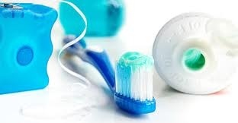
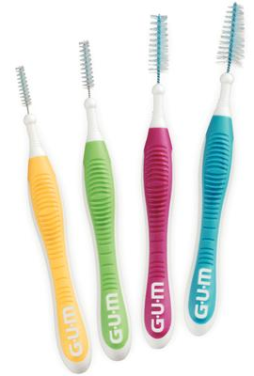
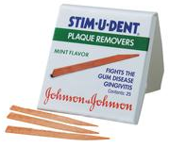
Dental Aids
Toothbrush
Manual or Electric
Floss
String or picks
Proxy brush
Cleans in between teeth
Rubber Tip Stimulator
Cleans under the gums
Dental Picks

