Slide 1
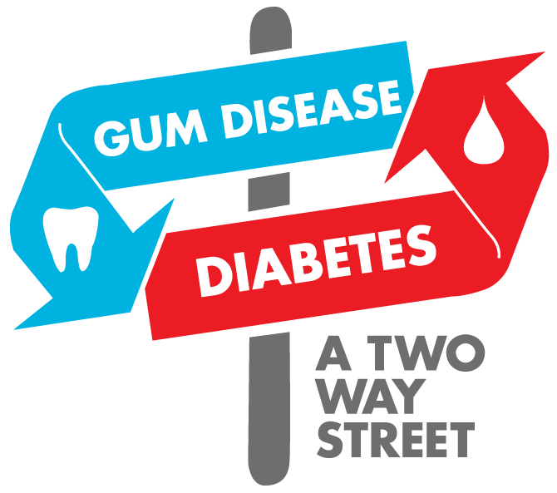
Oral Health and Diabetes
By Sally Wiedeman, EPDH, MBA

Slide 2
Objectives
Learn what factors contribute to our oral health
Evaluate the oral systemic link
Discuss oral concerns linked to diabetes
Review oral health preventatives

Slide 3
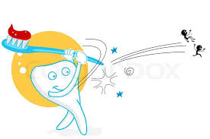
The Key Players
What oral factors do we look at?
Plaque
Calculus/Tartar
Bone Loss
Recession

Slide 4
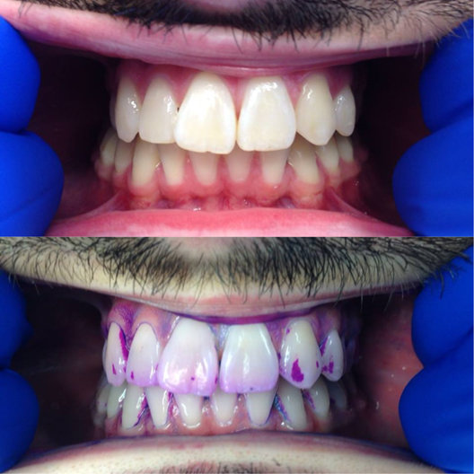
Plaque
Soft sticky film that builds up on teeth
Contains millions of bacteria
Can cause decay or gum disease if left untreated
Requires proper brushing and flossing to remove

Slide 5
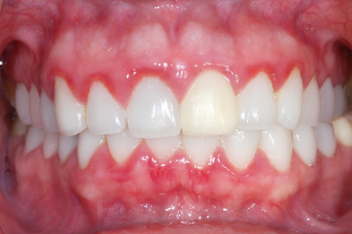
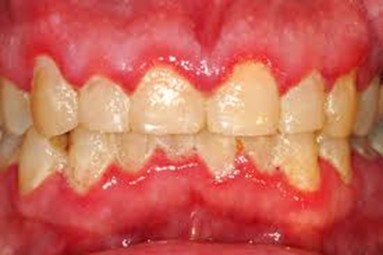
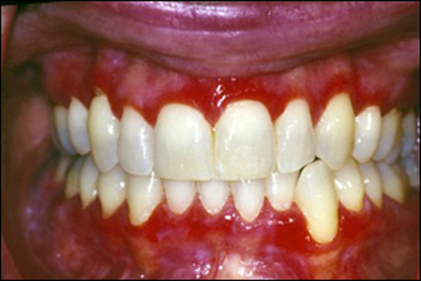
Gingivitis
Inflammation of the gums
MILD
MODERATE
SEVERE

Slide 6
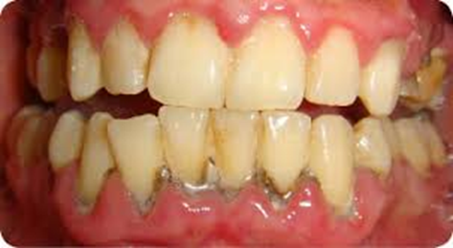
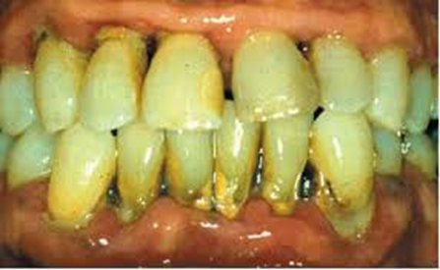
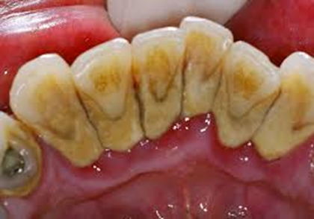
Calculus or Tartar
Form of hardened dental plaque
Cannot be removed with brushing or flossing, requires the use of dental instruments

Slide 7
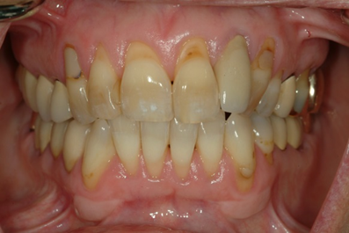
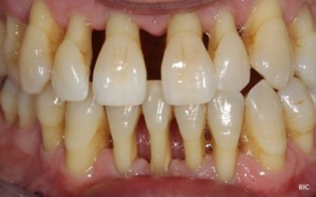
Recession
Loss of gum attachment
Gums pull away from the crowns of the teeth, exposing the roots
More susceptible to decay and sensitivity

Slide 8
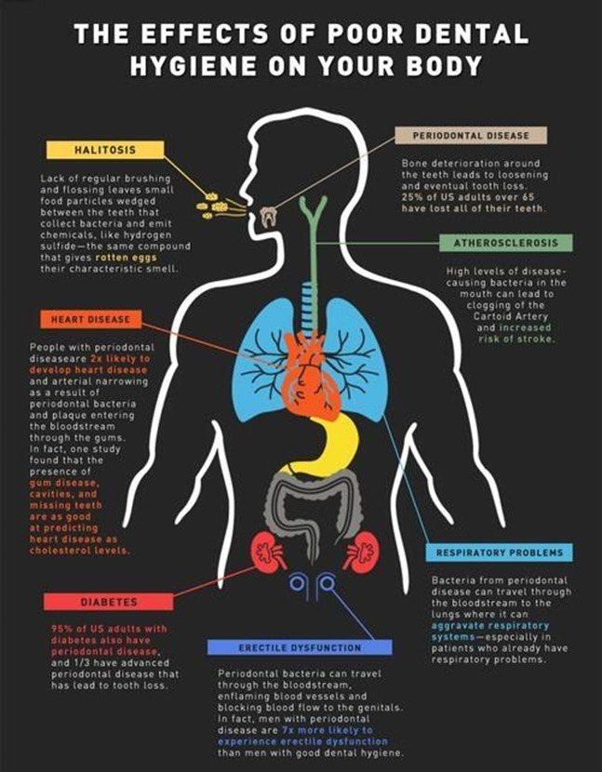
The Oral Systemic Link
Diabetes affects the ability to fight the bacteria in your mouth
High blood sugar levels increases the growth of bacteria
High levels of bacteria increases the risk of periodontal (gum) disease

Slide 9
Oral Issues Related to Diabetes
Periodontal/Gum Disease
Tooth Loss
Dry Mouth
Infections or Sores
Ill Fitting Dentures

Slide 10
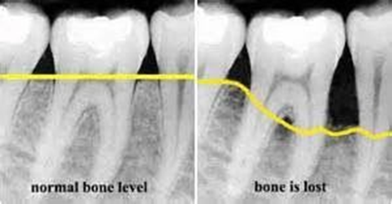
Periodontal or Gum Disease
Infection in the gums
Causes bleeding
Swelling
Bone loss

Slide 11
Periodontal or Gum Disease
95% of US adults with diabetes have periodontal disease
1/3 have advanced periodontal disease that has lead to tooth loss
Untreated can lead to other systemic problems

Slide 12
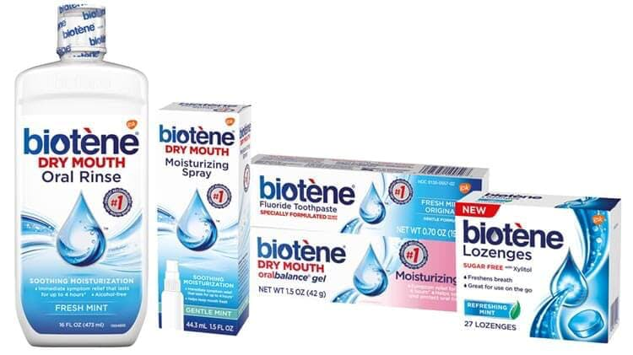
Dry Mouth
Reduction of saliva
Medications can decrease salivary flow
Increases risk of cavities
Can make eating spicy/acidic foods painful
What can help
Sip on water
Use fluoridated toothpaste and/or mouth rinse
Use a saliva substitute

Slide 13
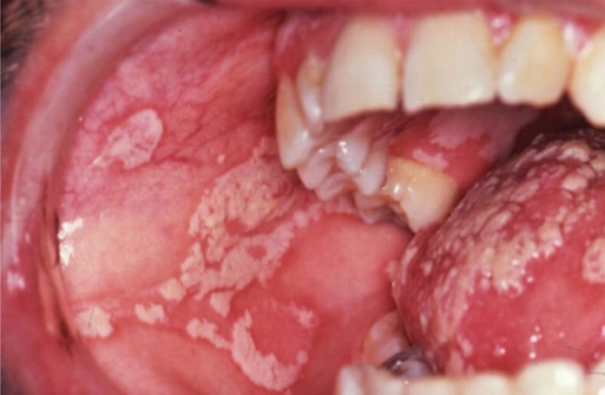
Oral Infections or Sores
Increased risk for thrush/oral candidiasis
White patches that do not wipe off
Burning sensation in the mouth
Can reduce ability to taste
Can turn into ulcers/canker sores
Treated with antifungal medication

Slide 14
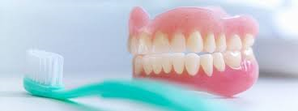
Denture Problems
Bone loss can cause dentures to not fit properly
Dirty dentures can cause gum irritation or infections
Remove dentures daily
Allows for gums to get oxygen
Brush off debris/bacteria
Have dentist or denturist check for needed adjustment and/or relines

Slide 15
What Can You Do?
See a dental provider
Routine dental exams and cleanings can:
Prevent or significantly reduce bacterial infections
Improve oral health
Reduce or eliminate oral pain
Reduce the need for extractions
Reduce risk of heart attack, stroke and cancer
Helps regulate healthy blood sugar levels
Exercise proper oral hygiene habits
Brush 2 times a day
Floss once a day

Slide 16
QUESTIONS?

