Slide 1


Oral Health and Pregnancy
Sally Wiedeman, EPDH, MBA

Slide 2
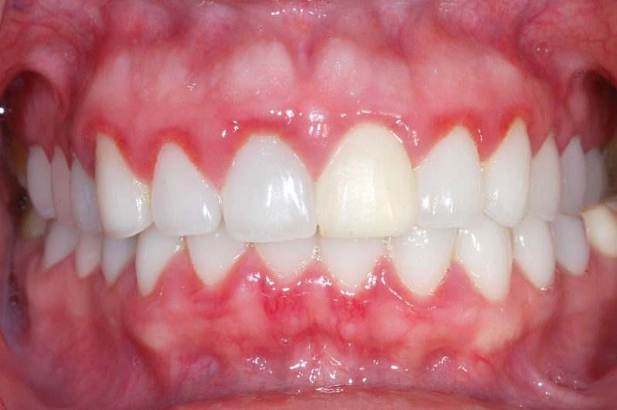
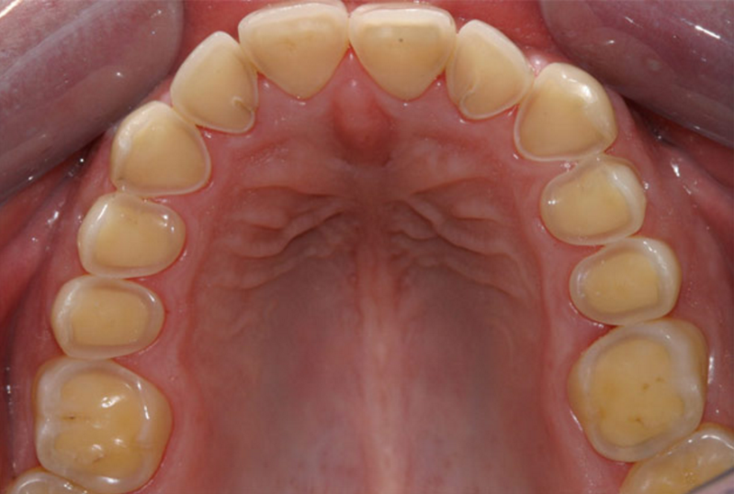
Common Oral Problems
Gingivitis
Enamel erosion
Dry mouth

Slide 3
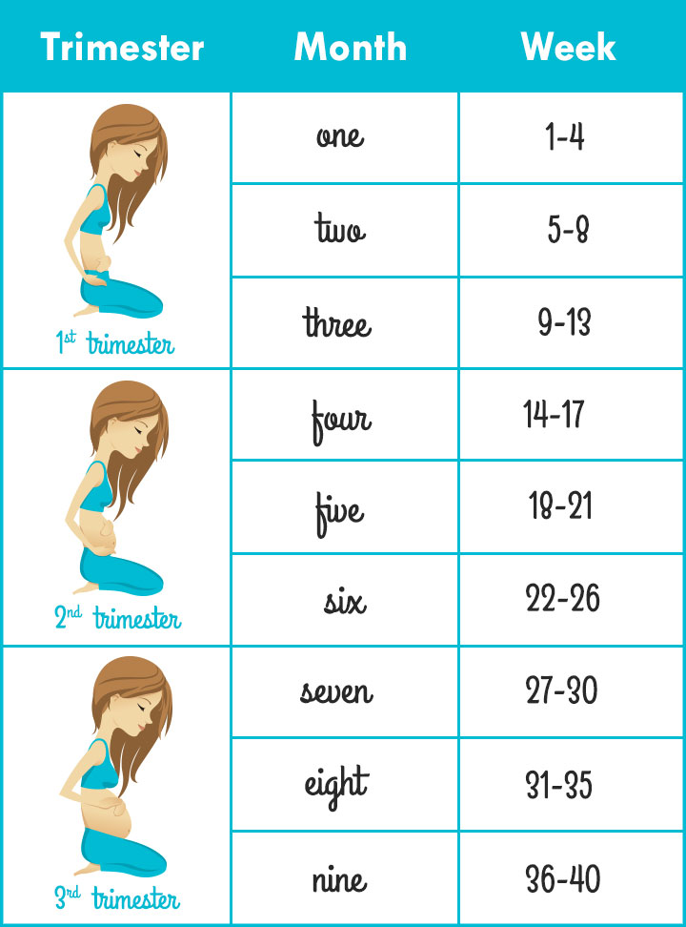
When Should You Be Treated
First trimester
  Exam and Preventative treatment
  ER treatment
Second trimester
  Best time for treatment
Third trimester
  Preventative treatment
    Cleaning
    Exam
**X-rays are safe for you and baby during all stages of pregnancy**

Slide 4

Tips for Good Oral Hygiene
Brush two times a day with fluoridated toothpaste
  Replace toothbrush every 3-4 months
  Do not share toothbrush
Floss once a day
  Common for gums to bleed with daily flossing while pregnant
Rinse with teaspoon of baking soda in a cup of water after vomiting to reduce acid erosion

Slide 5



Nutrition for Oral Health
Eat a healthy variety of foods
Drink plenty of water
Reduce the amount sugary foods and drinks
Ingest 5-10 grams of Xylitol a day

Slide 6

QUESTIONS?

