Slide 1


Slide 2








By: Emily Wineland, DDS and Sally Beach, RDH

Slide 3
 Needs Assessment
 Created survey for NARA’s non-dental providers to find out what information they want to know in order to become a more dentally-informed provider
 Emailed survey to 57 employees within YRTC, Residential, Outpatient, Diabetes, Pediatrics, and the Pregnancy Program
 Data collected from 26 respondents - survey participants
were entered into a raffle for a $50 gift card

Slide 4
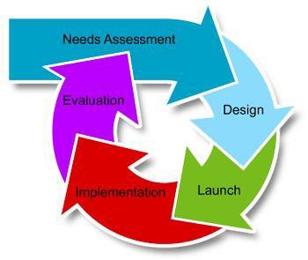
 Survey questions asked participants to please select their level
of interest in learning more about that particular topic.
 Answer options include: ‘Very important’, ‘somewhat important’, ‘not important’ and ‘not sure’
 “Very important” was selected more than 80% of the time for every question asked

Slide 5
How can patient care providers provide oral health screenings to
assess their patients’ dental needs?
What is a ‘dental emergency’?
When should I send my patient/client to the dentist?
How can I send my patient/client to the Nara Dental Clinic? What is the referral process?
What chronic or special conditions are affected by dental disease?
What are some factors that put patients/clients at-risk for dental problems?
What dental prevention therapies can providers offer to their
patients/clients?
Are there any patient/caregiver education materials I can give out to my patients/clients?
How can a patient care provider identify factors that impact oral
health and overall health?

Slide 6

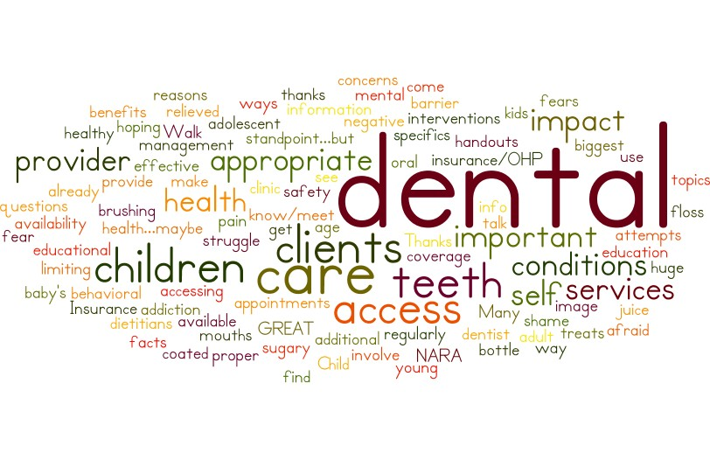
10) Finally, please describe any additional topics or questions you would like to know more about in order to better serve your patients’/clients’ dental needs.

Slide 7

Information gained from the Needs Assessment Survey will be
used to develop general training for NARA employees
What services the dental clinic offers
How to get patients into the dental clinic
What constitutes a dental emergency
Navigating dental insurance through the OHP Team
Additional education and materials will be tailored to NARA staff
at the individual programs we are collaborating with:
 YRTC, Residential, Outpatient, Diabetes, Pediatrics, and the Pregnancy Program

Slide 8
WHAT IS A DENTAL EMERGENCY?
NARA Dental Triage Sheet:What is a Dental Emergency?
Facial Swelling
Child in Pain
Pregnant woman in pain
Swelling
Fac1aswellrige:ctend1ngbeyondthe area oftheto((h, symptomsofmala 1oi=, fever
•S.:M pt<:M tote E.e ; r.cy Roc-r
Dental
Emergency
(same day care)
Patient in acute pain
Severe trauma to teeth
Urgent Dental
Care
(24-48 hours)
Routine Dental
Trauma
Mild or moderate pain
Minor dental trauma
Q• Send patient tothe Emer5ency Room
Care
Orofac1al trauma to structures other than
(2-6 wee ks)
teeth: hps, tongue, cheek, alveolar bone
Severe tooth trauma
• Urgent (within 2448hours)dentai<are
If patient 15ch1ld,Emergency [sarnedayjpriority
Minor tooth trauma (chipped tooth,broken filling)
• Routine [w1thn 2-6weeks)dentalcare
Thereis llO "one sizefits ar apprC3ch to triagirgdemal EmErgecric:i5.This informatioo is me•nt asa guide for you\\"'81de<idirighowbest to carefor yoUJ p3tems' demal nEE<k.When indoubt,pleaseca the ntal Clinic at (971)347-3009 tospeak with adental provooduririg
normal busness hours.for Illegeneral public,v-.e provide a limited numbet of emergeJICYwal­
inappointments daily from 7:30-lOam on a firstcome,fwst srvecl b•si>.
When should a patient be sent directly tothe ER?
Facialswelling thatrestrict:sswallow ngor extends beyoridthe area ofthe tooth (extends tothe eye,pharynx,sublingualorsubmaridibular spaces)
Symptoms of systemic infection such as malaise (feelingof discomfort)or fever
Trouble breathing
Troubleopening(trismus)
Uncontrolled bleeding
Facialtrauma that includes facial/orallacerationsor injurytothe facial bones

Slide 9
 Hours and walk-in hours/process
 Accessing the dental clinic/system for scheduling appt.
 Do they have to be a NARA patient?-No
 Cost-sliding scale/co-pay/no pay
 Triage
 Services
 How far out are we scheduling appts.

Slide 10

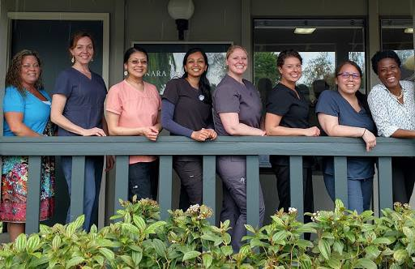
 Dental Team is currently providing outreach at:
 Residential
 Outpatient/CDC
 YRTC
 Diabetes Clinic
 Pregnancy Program
 NAYA

Slide 11

 Dental Therapist (DHAT), Ben Steward – dental screenings at NARA Residential beginning February ‘18
 Weekly (Tuesday) visits
 First 30 minutes, Ben presents a topic of interest to the Residential
adults, including time for discussion /feedback and questions
 Presentation topics have included: meth mouth, heroin effects on oral cavity, basic oral hygiene
 Ben performs “problem-focused” screenings for 6-8 patients, with
approximately 20-30 minutes per patient
 This takes the dental triaging load away from medical providers
 Patients needing additional evaluation or treatment can then be
scheduled at the dental clinic

Slide 12

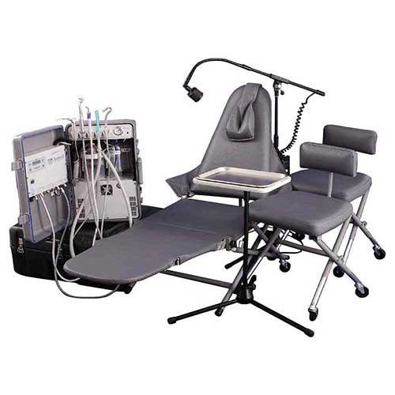
 Still in developmental phase:
 Hygienist to give educational talk to YRTC clients on the
second Tuesday of every month
 Expect to attend one Family Activity Night per quarter
 Future goals:
 Ability to complete basic cleanings on-site

Slide 13

 Dental hygienist performed oral screenings at Saturday
diabetes clinics in January and March
 Screenings provide opportunity to speak with patients about their oral health and diabetes
 Chance to establish rapport with community members who
haven’t used our dental services
 Opportunity to ensure patients have a dental home
 Patients needing further care are scheduled for an
appointment at the dental clinic

Slide 14



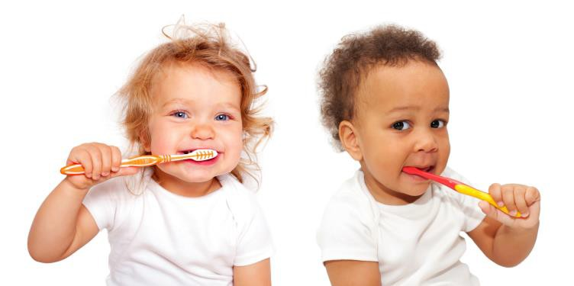
 This was our first outreach project, beginning in October 2016!
 Dental hygienist visits outpatient and residential CDC’s monthly.
 Visits consist of short educational component and screenings/fluoride applications as well as oral hygiene instructions to parents and caregivers.
 Helped to developed daily tooth brushing program at CDC, supplying them with toothbrushes for all age groups.
 Ben Steward, the DHAT will now be taking over the residential
CDC screening component.

Slide 15


 Attended special events to perform screenings,
including:
 Back to School Barbeque
 NAYA Health Fair
 WIC Days
 After School Program
 Upcoming outreach at NAYA:
 Spring Break Camp
 Expecting to screen 60 youth
 Connections Fair, April 18
 Sally and Emily will be attending career fair to discuss careers
within the dental field and to promote NARA dental

Slide 16

 Program is new to NARA, still in development
stages
 Created “Oral Healthcare during Pregnancy” informational sheet for clinics to give to patients
 NARA Dental’s goals:
 Reach 20 pregnant women in the next year
 Establish dental home
 Complete cleaning, exam, oral hygiene education prior
to delivery
 Steps to accomplish our goals:
 Provide medical clinics with a voucher for pregnant mothers to receive a diaper bag after they complete dental exam and cleaning
 This will establish integration between prenatal medical/dental care and give new moms information about caring for their baby’s dental needs

Slide 17

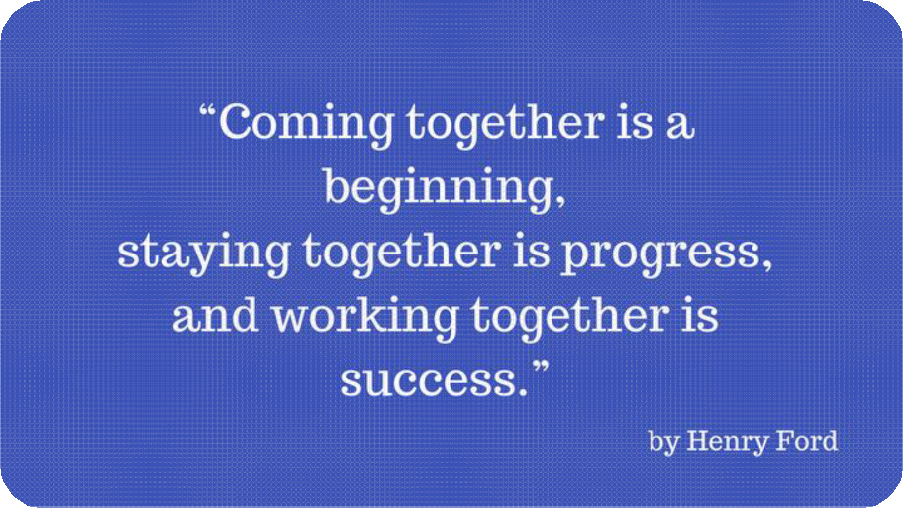
 Provide us with feedback
 Do not hesitate to reach out to us with questions
 Let us know of any events dental should participate in

