Slide 1
Prenatal to 5, Patient Activation Towards Health P-5 PATH
What, Who, & Why

Slide 2
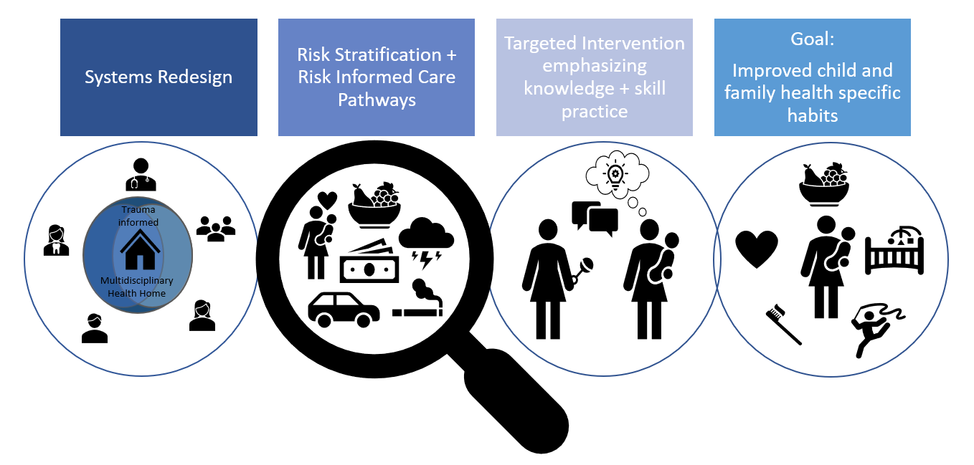
What is NHC’s P-5 Path?
Holistic, interdisciplinary healthcare model for pregnant women & 0-5 year olds
Integrated medical, dental, and modified behavioral health care
Includes risk screening and tailored care pathways
Plus universal as well as tailored intervention in the health home

Slide 3
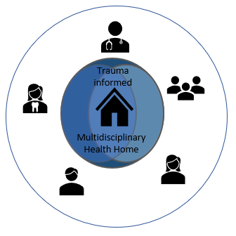
What is NHC’s P-5 Path?
Move towards care that is:
Team-based (Interdisciplinary)
Holistic
Trauma informed
Activation focused
Incorporating OT on care team
Building pediatric infrastructure
Implementing new tools and workflows
System Redesign

Slide 4
What is NHC’s P-5 Path?
Risk stratification & Risk informed care pathways
Carefully selected screening tools
Risk stratification based on responses
Risk score documented in chart
Care pathways based on risk levels:
Low- care as usual
Low moderate- handout/intervention in visit, referrals to groups
High moderate- phone & in office individual f/u
High- monthly check-ins in with OT.

Slide 5
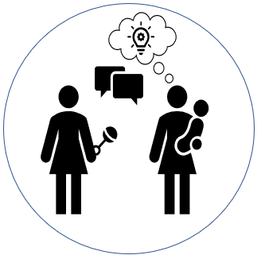
What is NHC’s P-5 Path?
Targeted intervention emphasizing knowledge + skill practice
Intervention provided in dental/primary care settings
Within dental visits
WCC visits
Phone follow ups
In-person f/u visits with OT
Group visits
Emphasis on connection to concrete resources first
Differing intervention intensity:
Population level interventions
Verbal anticipatory guidance
Visual activation focused (printed material)
Individualized intervention
Verbal coaching
Visual modeling
Kinesthetic practice of skills

Slide 6
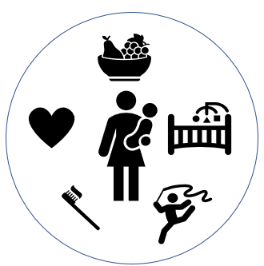
What is NHC’s P-5 Path?
Goal: Improve child and family health specific habits
Simple yet powerful daily habits:
Positive social connection
Brushing and flossing
Eating fruits and vegetables
Reading
Outdoor play and exercise
Restorative sleep

Slide 7
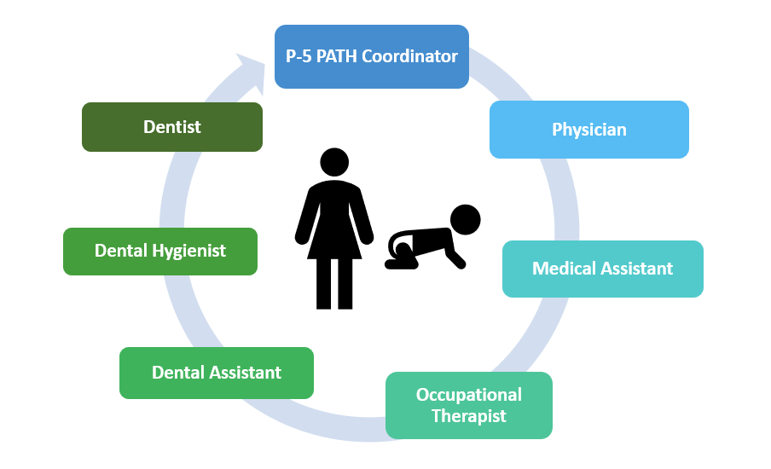
Who is NHC’s P-5 Path?
Trauma informed
+
+
=
Health Home

Slide 8
What is Patient Activation?
A person’s belief in their ability to manage and improve their health.
Activation is significantly correlated with:
Healthy behaviors
Appropriate use of the health care system
Consumeristic health behaviors
Chronic care self-management
Control of chronic illness
PARENT ACTIVATION
Green, J., Hibbard, J. H., (2012). Why does patient activation matter? An examination of the relationship between patient activation and health-related outcomes. Journal of General Internal Medicine. 27(5): 520-526.

Slide 9
Patient activation- 3 pillars
Knowledge
Skill
Confidence
Green, J., Hibbard, J. H., (2012). Why does patient activation matter? An examination of the relationship between patient activation and health-related outcomes. Journal of General Internal Medicine. 27(5): 520-526.
Notes:
Work of Carol Dweck on fixed vs growth mindset
ALL SIGNIFICANTLY IMPACTED BY FUNCTIONAL COGNITION

Slide 10
Why Occupational Therapy
“Occupational Therapy is the only spending category where additional spending has a statistically significant association with lower [hospital] readmission rates” (Rogers, Bai, Lavin, & Anderson, 2016)
We address motivation AND we focus on function
Roger, A.T., Bai, G., Lavin, R.A., Anderson, G.F., (2016). Higher hospital spending on occupational therapy is associated with lower readmission rates. Medical Care Research and Review. 74(6), 668-686.
Notes:
What we do influences our:
Health
Self-respect
Sense of dignity

Slide 11
Occupational science
“Mundane, everyday experiences affect psychological well-being to a greater extent than do major life events…and can be enormously health-promoting”
(Clarke, et al, 1990)

Slide 12
Standard health care
Why P-5 Path?
Patients consistently share “red flags”
No formal systems for identification or intervention.
Providers already picking up on some of these risks.
Universal lack of time for intervention for red flags.
Potential for missing “root cause” of illness and disease.
Care is often disconnected
Care focuses on “educating” families
Notes:
4 y/o girl in dental for bi-annual teeth cleaning, noted to have several cavities. Mom ID’s sugary foods as one source and DH counselled on reducing. Then mom mentioned kiddo sneaking out of bed at night to eat fruit by the foot and tooth fairy concerns…gave son $2/tooth- “will I have enough money to keep up with that?” Food insecurity? Access to healthy foods?

Slide 13
P-5 PATH
Why P-5 Path?
Children are an “upstream” population
Habits developed early tend to persist throughout life
Education must be contextualized with barriers addressed
We must help build skill for self-management
We can do more as a team

