Slide 1
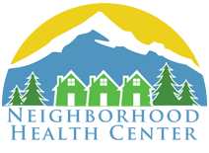
Achieving oral health equity & P-5 PATH
Using Occupational Science-Informed System Redesign, Trauma Informed Care, & Patient Activation in family medicine primary care
Notes:
This presentation is to describe and train on PA, OS, and TIC.

Slide 2
P-5 PATH Prenatal to 5 years, Patient Activation Towards Health
cdc.gov
Notes:
You already know this stuff and live this stuff. It’s nice to get a refresher bc this stuff matters. Our P5 PATH program focuses on children and families but it applies to all ages.
Despite risk factors, early identification and intervention works- we know that our health habits can have major life consequences and starting young to build healthy habits and change habits of parents can have a big upstream health payoff.

Slide 3
P-5 PATH Prenatal to 5 years, Patient Activation Towards Health
cdc.gov
Notes:
Again, we are targeting lifestyle risk factors to reduce risk of disease overtime. We’re just focusing on kids and parents.

Slide 4
P-5 PATH CORE PRINCIPLES
Trauma Informed Care
Self-regulation
Patient Activation
Occupational Science
Trauma informed
Strengths-based
Notes:
These are the guiding principles of P-5 PATH

Slide 5
Trauma informed Care
Trauma: Emotionally painful and distressing experiences
that overwhelm your ability to cope
Notes:
We all experience stress in our daily lives. Some stress is positive (like the stress of giving this presentation, which motivates me to study and come prepared). Some stress is tolerable (like an argument with a friend- not fun but you can stay calm, manage, and repair). Some stress is SO big or so persistent that it overwhelms our ability to cope or recover from it. This stress is TOXIC and research shows it impacts our ability to think and be healthy. MANY people deal with this type of stress. Since our job is health, trauma informed care recognizes that it’s best to take a universal precautions approach and help our patients feel safe, calm down, and stay regulated (organized/calm are synonyms) throughout the visit.

Slide 6
Sensory Processing Self regulation & Coregulation
Hyper arousal, sympathetic nervous system stress response
Self-regulated
Functional
Hypo arousal, shut down
1st step is to make people feel safe, calm, and in control
Notes:
We all have to cope and manage a wide variety of things throughout our day. Our body is working to manage physical, social, environmental stressors and to stay REGULATED. Trauma informed care asks us to practice providing care and creating and environment that supports a person in getting and staying regulated (organized/calm are synonyms).

Slide 7
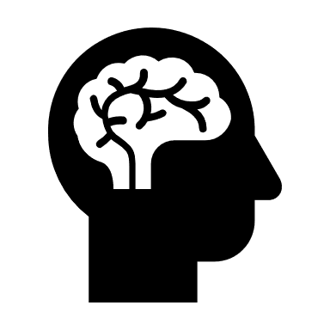
executive functions
Skills for tuning in to the right stuff, tuning out the not important stuff, setting goals, planning, organizing, and engaging in an activity
Notes:
When we are regulated we can develop and access our highest level brain functions- our executive functions. You need good EF skills to be good at your job and pretty much everything else in our adult life. Our patients need good EF skills to be successful parents, to manage their health, and to follow through with our recommendations. Trauma informed care supports out patient’s ability to stay calm and organized so that they can access their executive functions.

Slide 8
When you are experiencing
stress
you cannot access your executive functions & may make “bad choices” or mistakes
Notes:
UNDER STRESS YOUR BODY IS NOT FUNCTIONING NORMALLY- HEART BEATS FASTER, YOUR IMMUNE SYSTEM STARTS KICKING ON JUST IN CASE YOU GET HURT, YOU STOP DIGESTING FOOD, YOUR THROAT USUALLY TIGHTENS UP. YOU HAVE A HARDER TIME THINKING AND PLANNING FOR THE FUTURE.

Slide 9
Trauma informed Care
Prolonged exposure to high amounts of
STRESS IN CHILDHOOD IS TOXIC
Impacts every body system
Decreases long term ability to use executive functions
Increases risk for MANY diseases and early death
Harden, B. J. (2015). Services for families of infants and toddlers experiencing trauma: A research-to-practice brief. Brief prepared for the Ofﬁce of Planning, Research and Evaluation, Administration for Children and Families, U.S. Department of Health and Human Services.
Notes:
Not only do you have a harder time making good choices- research shows that over time, especially when we are exposed to high levels of stress in childhood, it’s actually TOXIC for our brain and will change the structure of the brain (larger amygdala, which is the part of our brain that searches for danger / smaller hippocampus, which helps us remember things.) Research also shows that overtime, exposure to high levels of stress significantly increases our risk of illness and premature death.

Slide 10
Trauma informed Care What does this mean for you
Prioritize:
Decreased stress in daily life
Healthy and loving relationships
Developing and practicing coping strategies
Trauma Informed Oregon
Notes:
Knowing this, allows those of us who are working directly with families to prioritize interventions which screen for and address stress and trauma. These things make a real difference.
mindfulness, deep breaths, sleep, healthy diet, being in nature

Slide 11
Patient activation
Process of engaging and motivating patients to
take an active role in care
More healthy behaviors
Appropriate use of the health care system
Chronic condition self-management
Green, J., Hibbard, J. H., (2012). Why does patient activation matter? An examination of the relationship between patient activation and health-related outcomes. Journal of General Internal Medicine. 27(5): 520-526.
Notes:
A person’s belief in their ability to manage and improve their own health. Patients should play a central role in determining the need for care and the outcomes of care. Activation is significantly correlated:
a 2% decrease in hospitalization and 2% increase in medication adherence

Slide 12
Patient activation
KNOWLEDGE
SKILLS
CONFIDENCE
Green, J., Hibbard, J. H., (2012). Why does patient activation matter? An examination of the relationship between patient activation and health-related outcomes. Journal of General Internal Medicine. 27(5): 520-526.
Notes:
We need to address all 3 areas- not just “knowledge” by giving education.

Slide 13
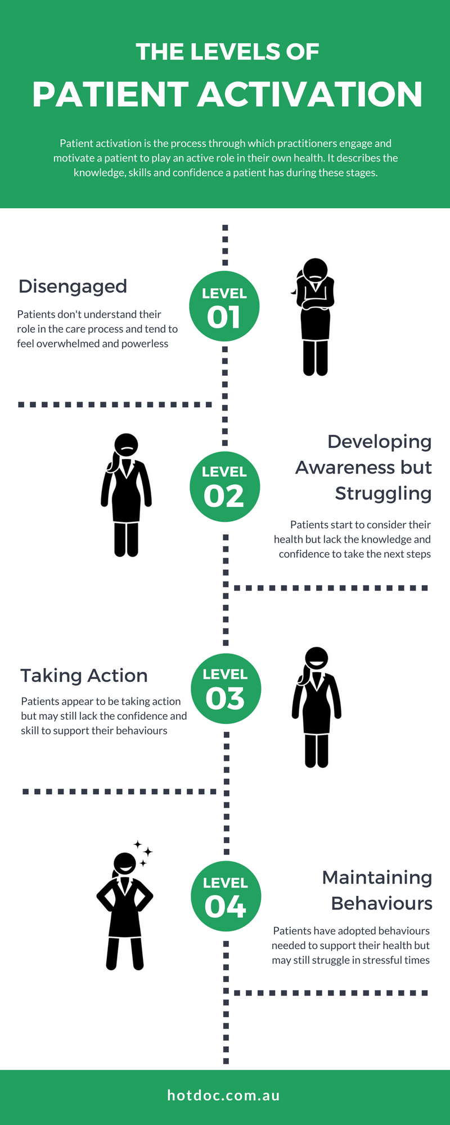
Patient activation
Green, J., Hibbard, J. H., (2012). Why does patient activation matter? An examination of the relationship between patient activation and health-related outcomes. Journal of General Internal Medicine. 27(5): 520-526.
Notes:
4 levels-
Low activation- disengaged & overwhelmed
Developing awareness, can do simple tasks and goals
Taking some action
Maintaining daily actions

Slide 14
Occupational science
“How we spend our days is, of course, how we spend our lives.”
-Annie Dillard
An occupation is any meaningful activity
that “occupies” your time during the day!
Notes:
What we do:
Defines us
Creates meaning for our lives
Can promote health OR detract from our health if our occupations are unhealthy or out of balance
Either way, they have a HUGE impact on our lives.

Slide 15
Occupational science
Core beliefs: Humans are complex systems in complex environments, engaged in complex activities
Person
Occupation
Environment
Reciprocal
Dynamic
Health
Notes:
Cannot separate out these systems, we are people in the context of our environment and our activities- a balanced overlapping interaction of these 3 areas produces satisfying occupational engagement and optimal occupational performance. We must keep all 3 areas in mind when helping our patients. This can help them make adaptations, address barriers, and contextualize our recommendations.

Slide 16
Occupation: Health Engagement and management
Scheduling appointments
Keeping track of appointments
Getting to those appointments on time
Listening to what your doctor tells you
Asking clarifying questions
Writing things down
Following up on referrals
Making follow up appointments
Finding community resources
Notes:
One example of what OTs can address in primary care: The occupation of Health engagement and management. And every occupation can be broken down into it’s component parts (each of these steps can be further broken down!) to help understand what is going wrong and how we can help.
Each of these steps can feel hard and confusing to our patients. We are here to support and help them, show compassion and make them feel safe and successful.

Slide 17
Occupational science
Interventions must prioritize “doing” and practice in addition to teaching. Skills must become HABITS.
People need to “do” in order to learn
Notes:
Primary care needs to support practice of healthy habits, not just teaching about helathy habits.

