Slide 1
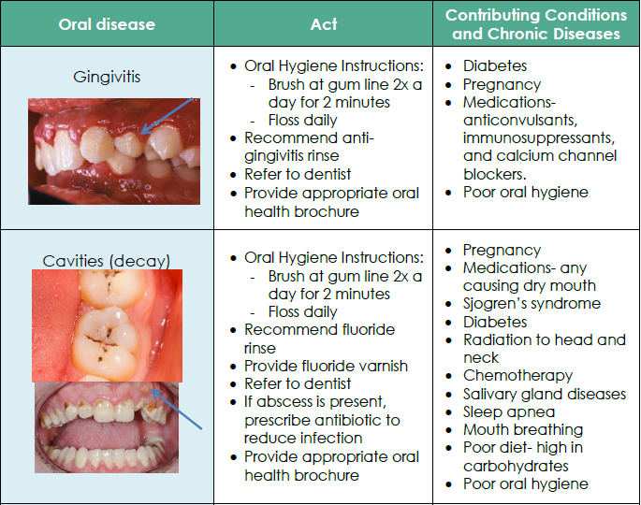
Decide/Act
Oregon Oral Health Coalition, (n.d) Oral Health and Chronic Disease Integration Guide, https://static1.squarespace.com/static/554bd5a0e4b06ed592559a39/t/5994bf77bebafbd3d152a8ce/1502920568547/OHCD+Integration+Guide.pdf
Notes:
Let’s review the activity you just went through and see how you did. (answer any questions they have about the correct answers)

Slide 2
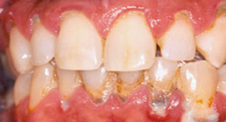
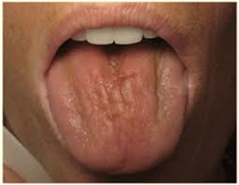
Decide/Act
Oral Disease | Act | Associated with this chronic disease
Periodontitis | Oral Hygiene Instructions: Brush at gum line 2x a day for 2 minutes Floss daily Recommend anti-gingivitis rinse Referral for periodontal treatment within one month Provide appropriate oral health brochure | Diabetes Heart Disease Stroke Pulmonary diseases Rheumatoid arthritis Adverse pregnancy outcomes Poor oral hygiene Smoking
Xerostomia (Dry Mouth) | Recommend rinsing with fluoride mouthwash to prevent cavities Avoid tobacco, caffeine, and alcoholic beverages Take frequent sips of water to improve function and comfort Recommend saliva substitutes Consider comparable medications that do not decrease saliva flow Advise patient to maintain a healthy diet, avoiding frequent starches and sugars Refer to dentist Provide appropriate oral health brochure | Cancer: Chemotherapy Radiation- particularly of the head and neck Medication side effects Autoimmune diseases- Sjogren’s, HIV Tobacco and methamphetamine use Diabetes
Oregon Oral Health Coalition, (n.d) Oral Health and Chronic Disease Integration Guide, https://static1.squarespace.com/static/554bd5a0e4b06ed592559a39/t/5994bf77bebafbd3d152a8ce/1502920568547/OHCD+Integration+Guide.pdf
Notes:
Let’s review the activity you just went through and see how you did. (answer any questions they have about the correct answers)

Slide 3
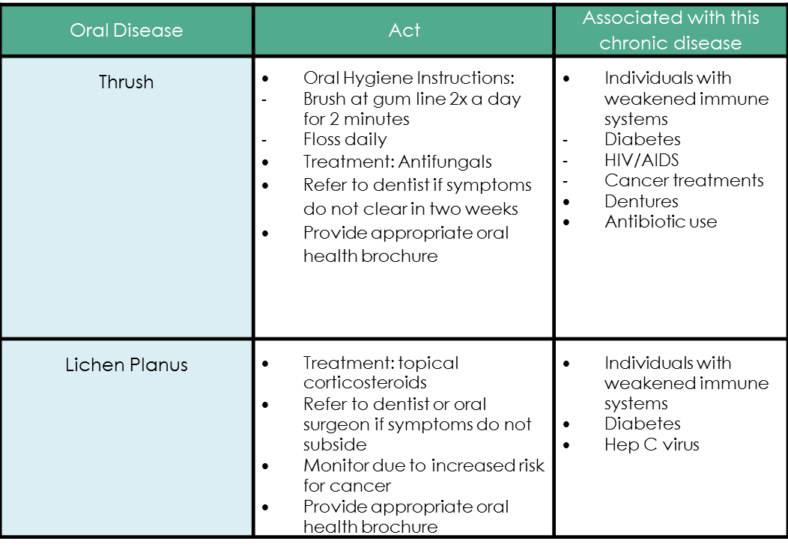
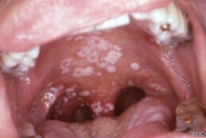
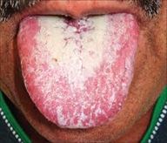
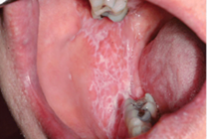
Decide/Act
Oregon Oral Health Coalition, (n.d) Oral Health and Chronic Disease Integration Guide, https://static1.squarespace.com/static/554bd5a0e4b06ed592559a39/t/5994bf77bebafbd3d152a8ce/1502920568547/OHCD+Integration+Guide.pdf
Notes:
Let’s review the activity you just went through and see how you did. (answer any questions they have about the correct answers)

Slide 4
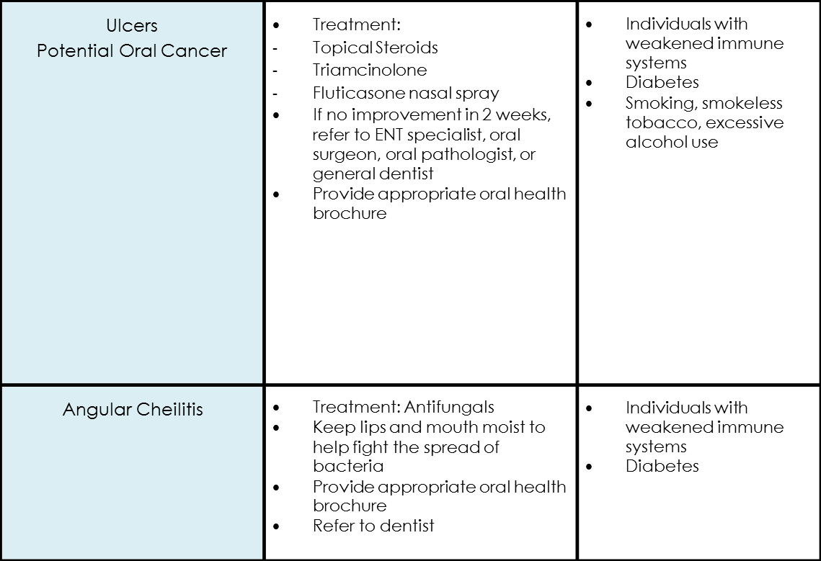
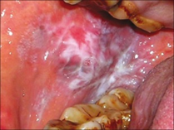
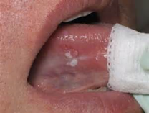
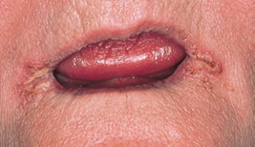
Decide/Act
Oral Disease | Act | Associated with this chronic disease
Oregon Oral Health Coalition, (n.d) Oral Health and Chronic Disease Integration Guide, https://static1.squarespace.com/static/554bd5a0e4b06ed592559a39/t/5994bf77bebafbd3d152a8ce/1502920568547/OHCD+Integration+Guide.pdf
Notes:
Let’s review the activity you just went through and see how you did. (answer any questions they have about the correct answers)

