Slide 1
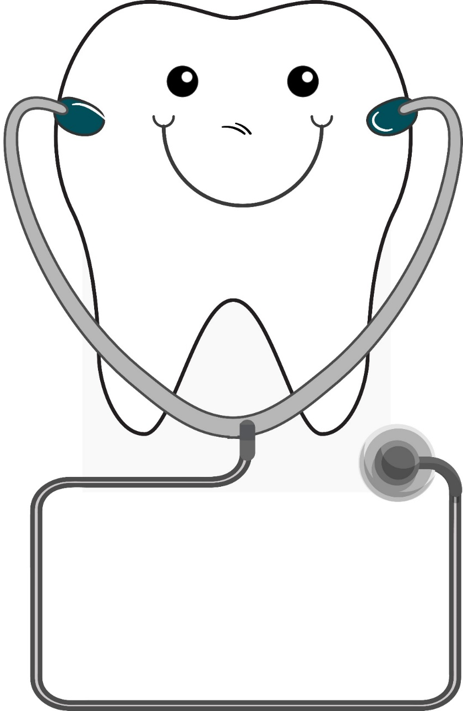

Oral Health and Diabetes
Happy Mouth
Happy Body
Ann Turner, MD
Alison Reta, PharmD, CDE
Lisa Bozzetti, DDS
Notes:
To ensure optimal integration, the project is co-sponsored.
So big and important, we needed a mascot to rally behind – Dr. Tomas Medident.

Slide 2

Overview
Our Goals
Promote oral health integration between VG primary care and dental providers
Educate our medical professionals on oral manifestations of diabetes and encourage referral for dental exams.
Provide resources for providers to educate patients on the importance of good oral health for diabetes management
Provide recommendations for integrating oral health education and preventive services into primary care visits

Slide 3
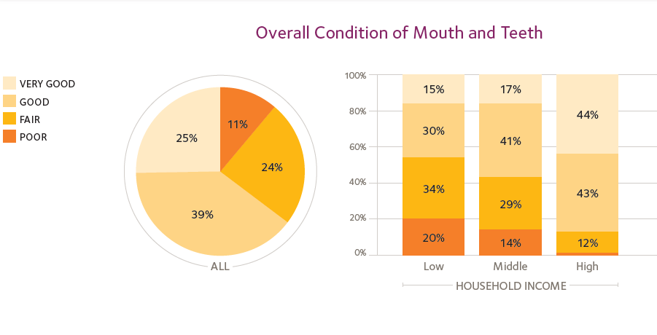
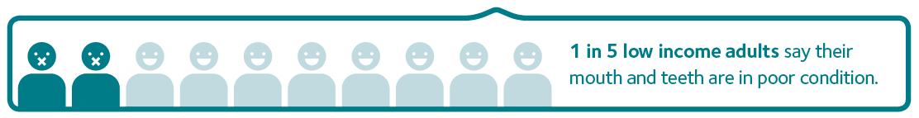
Patient Perceptions
(Oral Health and Well-Being in Oregon, HPI)
Notes:
Interestingly, according to the American Dental Association Health Policy Institute, 64% of all adults in the US believe the overall condition of their mouth and teeth is good or very good.
Note the differences in income levels and perceptions.
Reference
Oral Health and Well-Being in Oregon. (n.d.). Retrieved August 17, 2016, from http://www.ada.org/~/media/ADA/Science and Research/HPI/OralHealthWell-Being-StateFacts/Oregon-Oral-Health-Well-Being.pdf

Slide 4
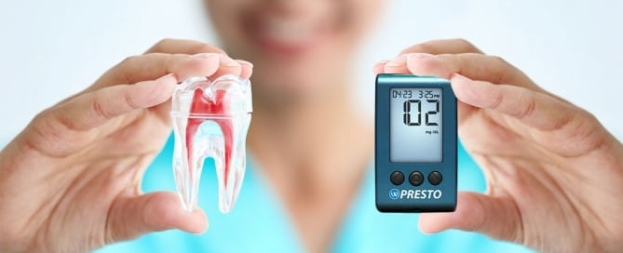
Oral Health and Chronic Disease
Poor oral health is linked to several chronic diseases, particularly those exacerbated by inflammation.
The most common oral diseases- tooth decay and gum disease, share common risk factors with chronic diseases such as diabetes, heart disease and pulmonary diseases.
In 2012 - ½ of adults 18 and older had 1 or more chronic diseases (CDC, 2016)
Notes:
(speaker notes: May not want to give too much detail for fear of generating too many questions, but here are some details if providers want more details when viewing this slide)
Poor oral health can be linked to many chronic diseases such as CVD, stroke, type 2 diabetes, and certain cancers , particularly diseases that research is finding are inflammatory in nature. More research is needed to determine the exact association between periodontal disease and chronic diseases, but there is clearly evidence suggesting a correlation. Additionally over 100 systemic conditions have oral health manifestations including nutritional deficiencies, autoimmune diseases, CVD, stroke, respiratory infections, diabetes and pancreatic cancers.
It is not surprising that as of 2012, about half of all adults in the US—117 million people—had one or more chronic health conditions. Having multiple chronic diseases compounds poor overall health, which in turn can leave a person susceptible to poor oral health, continuing the cycle.
Common risk factors include poverty, diet, hygiene, smoking, alcohol use, and stress
http://www.astdd.org/docs/integrating-oral-health-education-policy-statement-august-12-2013.doc
References
Chronic Disease Overview. (2015, August 26). Retrieved August 17, 2016, from http://www.cdc.gov/chronicdisease/overview/

Slide 5
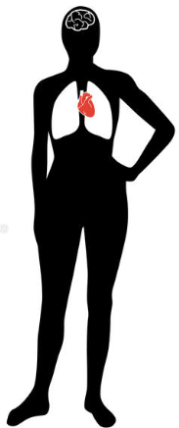

Systemic relationships
of
oral health
and overall health
Oral cancer can develop and easily spread throughout the body.
HPV causes 70% of OPCs in the US.
Hormones produced by stress and depression may contribute to gum disease
Bacteria in the mouth can be inhaled into lungs and may lead to respiratory complications such as pneumonia
Poor oral health may lead to higher risk for heart disease and stroke
Oral bacteria can lead to pre-term and low birthweight babies
There are links between kidney disease and oral health conditions
Patients with diabetes are more likely to have gum disease. Chronic periodontal disease can weaken diabetic control.
Non-diabetics with poor oral health may be more susceptible to developing diabetes.
Periodontal disease and edentulism is associated with pancreatic cancer
Rheumatoid arthritis may be linked to severe periodontal disease

Slide 6
Diabetes: a two-way relationship
Bidirectional
Diabetes (especially poorly controlled), leads to increased prevalence and severity of periodontal disease
Periodontal treatment is associated with glycemic control improvements and improved health outcome
Notes:
Visual – hold up your hand - if a diabetic presented with a lesion about the size of the palm of your hand, as a provider you would be very concerned. If you take the gum tissue, it would be similar in size so having perio is comparable to having a palm-sized lesion.

Slide 7
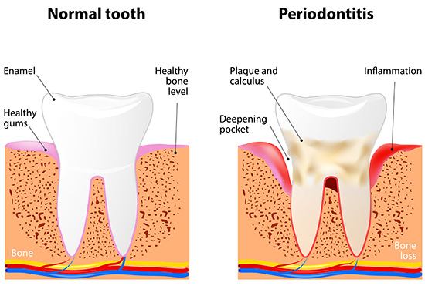
What is periodontal disease?
Disease of gum tissue, ligament and bone affects 90% of the world population
46% of US adults age 30+ with at least 1 natural tooth had periodontal disease
Irreversible, painless
Bone destruction
Tooth loss
Can’t diagnose visually
Notes:
Estimated from consensus reports by Int Diabetes Fed and European Fed of Periodontology
US Diabetes Stats from NHANES 2009-2012

Slide 8
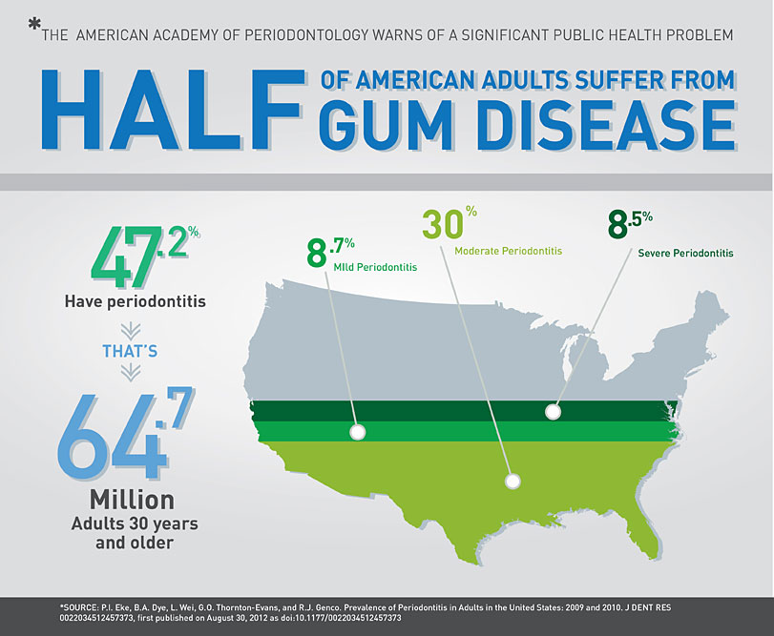
Notes:
According to the CDC, “one out of every two American adults ages 30 and over has periodontal disease”.
47.2 percent adults (64.7 million) in the US have periodontal disease and in ages 65 and older prevalence rates increase to 70.1%. This condition is more common in men than women (56.4% vs 38.4%), those living below the federal poverty level (65.4%), those with less than a high school education (66.9%), and current smokers (64.2%)
Gum disease is one of the most prevalent chronic diseases, similar to cardiovascular disease. The surgeon general called oral disease a silent epidemic
From 2011-2012 27.4% of adults (20-44 years old) had untreated dental caries.
Dental caries are treatable, yet some individuals do not receive treatment which can cause more problems.
References
Periodontal Disease. (2013, July 10). Retrieved August 17, 2016, from http://www.cdc.gov/oralhealth/periodontal_disease/
P.I. Eke, B.A. Dye, L. Wei, G.O. Thornton-Evans, and R.J. Genco. Prevalence of Periodontitis in Adults in the United States: 2009 and 2010. J DENT RES 0022034512457373, first published on August 30, 2012 as doi:10.1177/0022034512457373
CDC: Half of American Adults Have Periodontal Disease | Perio.org. (n.d.). Retrieved August 17, 2016, from https://www.perio.org/consumer/cdc-study.htm
Oral and Dental Health. (2014, December 2). Retrieved August 17, 2016, from http://www.cdc.gov/nchs/fastats/dental.htm

Slide 9
Major risk factors for perio disease
Biofilm leads to inflammation
  Biofilm level independent
  Presence of tobacco use and diabetes are stronger risk factors than amount of biofilm present
Diabetes
  Overall risk increases 2-3x over patients without diabetes
  Magnitude proportional to glycemic control
  HbA1c <7 → no increased risk
  Risk increase exponentially with poor glycemic control
Notes:
Plaque is an accumulation of biofilm

Slide 10

Endotoxemia causes chronic systemic inflammation
Immuno-inflammatory molecules response
Type 2 Diabetes
Hyperglycemia
h AGEs impair neutrophil function and activate RAGEs
h proinflammatory cytokines
Periodontal Disease
Host response and invasion into periodontium
Penetration of periodontal pathogens into lamina propria
h vascular permeability and enhanced tissue destruction
Insulin resistance
Oral Biofilm
The Two-way Association of Periodontal Infection with Systemic Disorders: An Overview Mediators Inflamm. 2015 https://www.ncbi.nlm.nih.gov/pmc/articles/PMC4539125

Slide 11
And... periodontal disease can affect diabetes
Periodontal disease is linked to diabetes related health outcomes
Severity of periodontal disease predicts occurrence of diabetes related diseases in a “dose dependent” manner
Periodontal treatment may improve glycemic control of some patients
Notes:
Remember this is not a one-and-done approach. One treatment may have a small (.4%) improvement in HbA1c, but continued treatment is associated with improve overall health.
(speaker notes: May not want to give too much detail for fear of generating too many questions, but here are some details if providers want more details when viewing this slide. Can right click to Unhide slide 11 that shows details below)
Benefits in 1% A1c reduction leads to better health outcomes
21% drop in deaths
14% reduction in MI
37% reduction in microvascular complications

Slide 12
HbA1c control and periodontal therapy
Systematic Reviews and Meta-analysis and Cochrane Review - 2014
0.4% improvement in HbA1c
Mixed literature on A1c control and periodontal therapy
Remember: benefits of 1% HbA1c reduction leads to better health outcomes
  21% drop in deaths
  14% reduction in MI
  37% reduction in microvascular complications

Slide 13
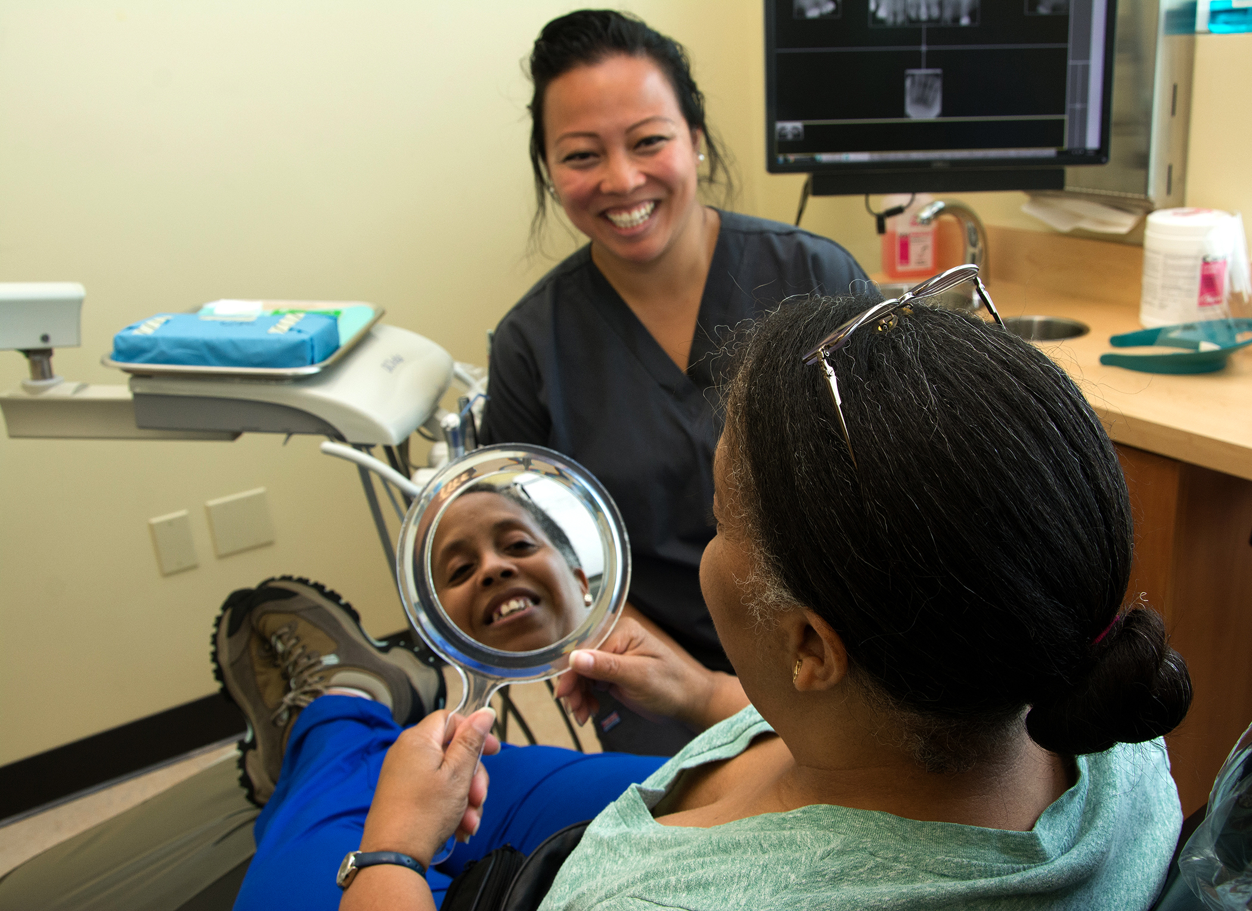
Key messages to patients
Oral health is part of routine diabetes care.
All patients with diabetes should have an annual dental exam.
Notes:
two-way relationship between glycemic (blood glucose) levels and periodontal disease (gum disease)
Please talk to your patients about oral health and encourage to have a dental exam at least once a year

Slide 14
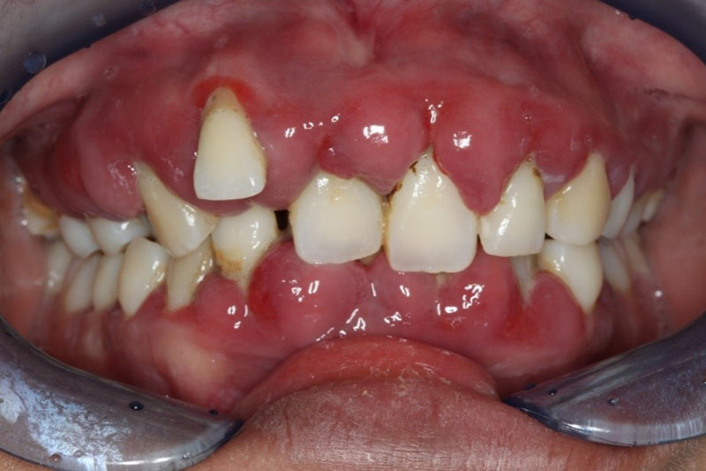
Assess, Advise, Refer to Dental
Ask the date of the patient’s last dental visit
Ask about oral health symptoms
  Sore, swollen, bleeding gums
  Loose teeth, change in tooth position
  Bad taste or breath
  Mouth infections (i.e. thrush)
Advise patient to schedule a dental visit
Refer for dental services
Notes:
Patients listen to you, their primary care provider. For example - over 75% of women at the women’s clinic sought dental care through the co-located hygienist because their provider recommended they do so. It wasn’t merely because it was more convenient….

Slide 15
Patients that can be seen at VG Dental
Accepted insurances:
Eligible for comprehensive care: Patients assigned by CareOregon and
Eligible for urgent care:
Anyone with an urgent dental concern can come to a dental clinic at 7:30 a.m. for triage and
treatment options. Bring proof of income if uninsured.
Insurances never accepted at VG:
Patients may select to change dental plans, but as long as they are covered by the above plans, they will need to contact their dental plan to schedule with a covered dentist.
CareOregon Dental | Capitol Dental | Open Card
CAWEM Plus | ODS Delta Dental | Family Dental
Children | Pregnant Patients | Patients with Diabetes(Uninsured if A1c>9)
Willamette Dental | Advantage Dental | Kaiser Dental

Slide 16
Key Messages- Diabetes
Practice good oral hygiene
Brush teeth twice daily for two minutes with a soft toothbrush and a pea-sized amount fluoride toothpaste.
Clean between the teeth with floss or interdental aids one time daily.
Good oral hygiene can improve glycemic control.
Eat nutritious food to control blood sugar
Limit foods containing high amounts of sugar.
Choose water or low-fat milk, and avoid carbonated beverages.
Choose fruit rather than fruit juice.
Make a dental appointment – REFER TO DENTAL FOR AN EXAM (will be a challenge metric next year)
Do not delay dental treatment until symptoms occur.
Dental treatment is safe and necessary for patients with diabetes.
Controlling periodontal disease can control glycemic control, keep regular dental hygiene appointments.
Notes:
Here are some key messages for patients with diabetes (go through these)

Slide 17
Key Messages- Dry Mouth
Practice good oral hygiene
Brush teeth twice daily for two minutes with a soft toothbrush and a pea-sized amount fluoride toothpaste.
Clean between the teeth with floss or interdental aids one time daily.
Keep mouth moist by drinking plenty of water and using sugar-free saliva substitutes.
Use fluoride rinse to prevent tooth decay.
Choose alcohol-free mouth rinses.
Eat nutritious food to minimize sugar intake
Limit foods containing high amounts of sugar (starches and acids) which can increase cavity risk.
Choose water or low-fat milk, and avoid carbonated beverages.
Choose fruit rather than fruit juice.
Make a dental appointment
Dental providers can look for earliest signs of decay or gum disease and prevent extensive disease.
Tell your dental provider that you have dry mouth.
.
Notes:
Here are some key messages for patients with dry mouth (go through these)

Slide 18
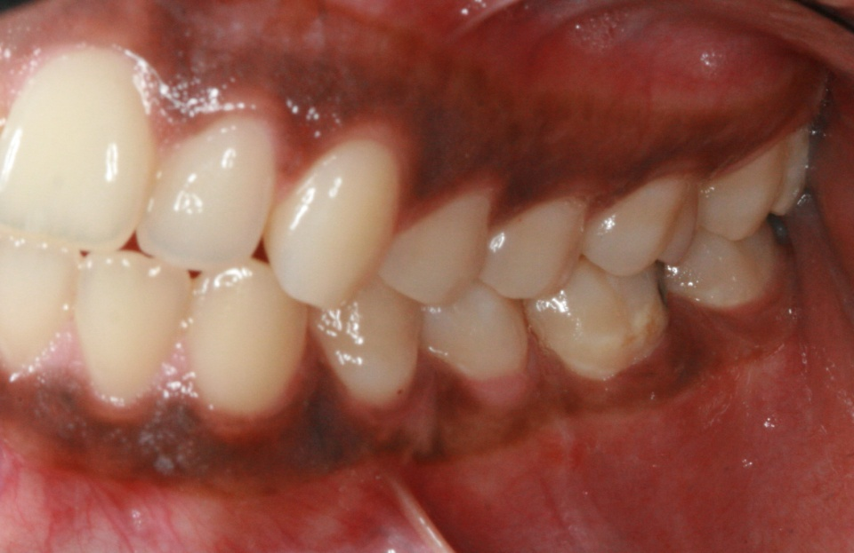
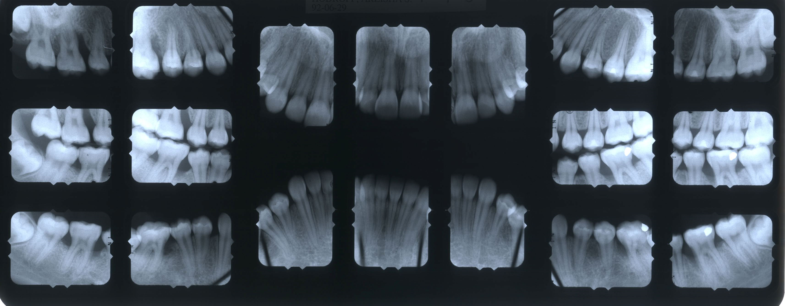
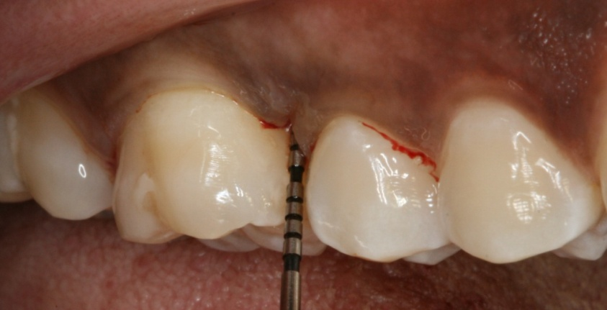
Why is a dental exam important for patients with chronic disease?
Periodontal disease may not be obvious without a periodontal examination
Clinically healthy mouth
Radiographs demonstrate localized severe bone loss
Probing shows a deep pocket depth
Courtesy: Dr. Harjit Singh Sehgal, OHSU Dental Faculty
Notes:
Since periodontal disease doesn’t always have clinical manifestations, it is important for adults to have a regular periodontal exam, complete with xrays and periodontal probe recordings, at least yearly.
These pictures and radiographs are of a patient at OHSU. Clinically the teeth look healthy. But when an exam with periodontal probing is completed, there is clearly bone loss on the upper left first molar. Radiographs confirm the extensive bone loss. So even though there is not gum recession, the destruction to the supporting structures is almost complete. This tooth is likely quite mobile.

Slide 19
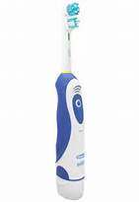
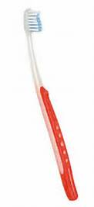
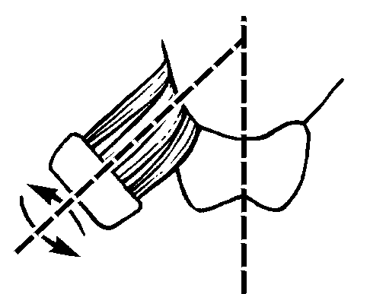
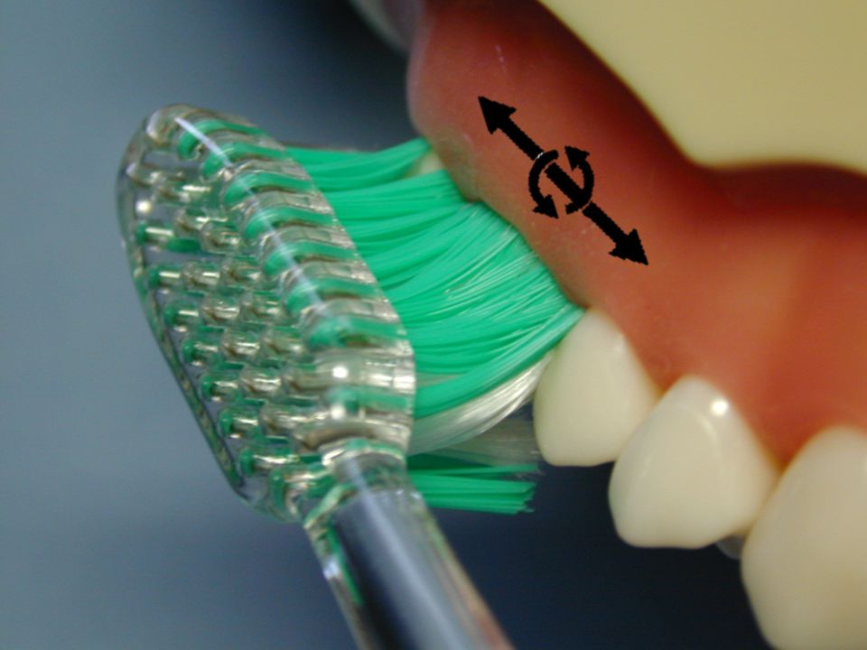
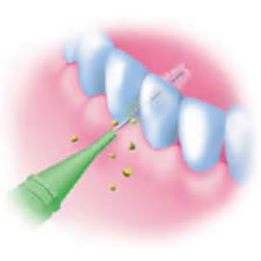
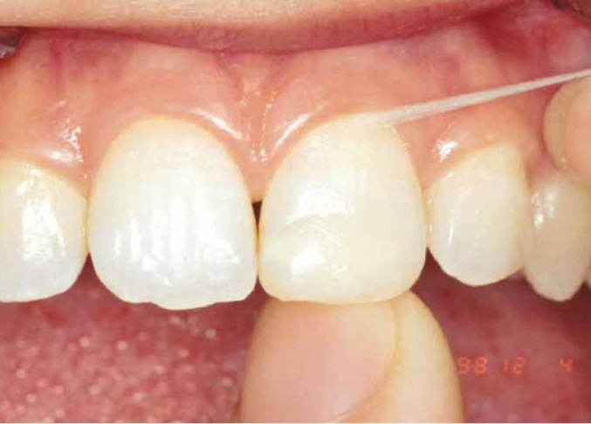
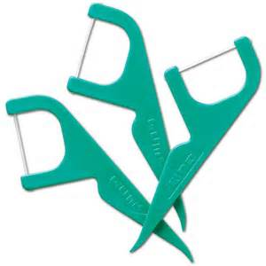
Oral hygiene Instruction
Notes:
It really is a patient preference if they prefer to use a manual or an automated toothbrush. For those who don’t do an adequate job of brushing, automated toothbrushes, either electric or battery powered, do remove plaque better. It is important to recommend a SOFT toothbrush only, angle the toothbrush bristles towards the gum line, and use either small circular motion or SHORT back and forth motion.
Flossing can be difficult for many people. Ideally the floss should hug the sides of the teeth to be most effective. Using interdental brushes, sponges or toothpicks can also keep the area between the teeth clean.

Slide 20
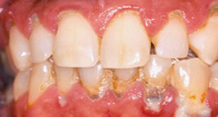
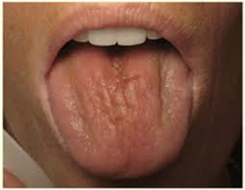
Decide/Act
Oral Disease | Act | Associated with this chronic disease
Periodontitis | Oral Hygiene Instructions: Brush at gum line 2x a day for 2 minutes Floss daily Recommend anti-gingivitis rinse Referral for periodontal treatment within one month Provide appropriate oral health brochure | Diabetes Heart Disease Stroke Pulmonary diseases Rheumatoid arthritis Adverse pregnancy outcomes Poor oral hygiene Smoking
Xerostomia (Dry Mouth) | Recommend rinsing with fluoride mouthwash to prevent cavities Avoid tobacco, caffeine, and alcoholic beverages Take frequent sips of water to improve function and comfort Recommend saliva substitutes Consider comparable medications that do not decrease saliva flow Advise patient to maintain a healthy diet, avoiding frequent starches and sugars Refer to dentist Provide appropriate oral health brochure | Cancer: Chemotherapy Radiation- particularly of the head and neck Medication side effects Autoimmune diseases- Sjogren’s, HIV Tobacco and methamphetamine use Diabetes
Oregon Oral Health Coalition, (n.d) Oral Health and Chronic Disease Integration Guide, https://static1.squarespace.com/static/554bd5a0e4b06ed592559a39/t/5994bf77bebafbd3d152a8ce/1502920568547/OHCD+Integration+Guide.pdf
Notes:
Let’s review the activity you just went through and see how you did. (answer any questions they have about the correct answers)

Slide 21
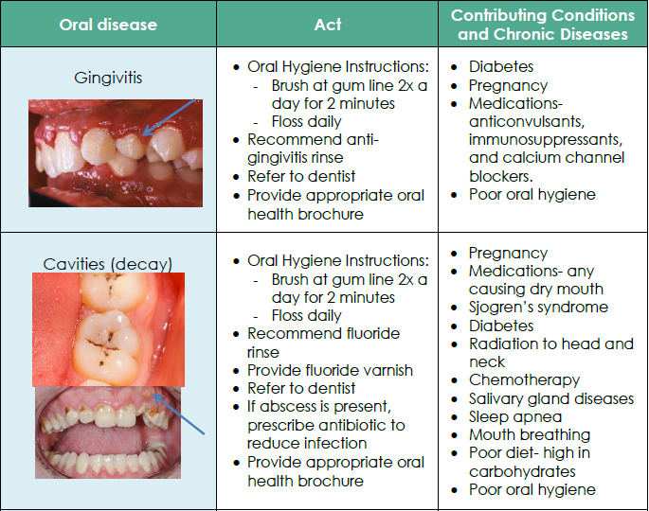
Decide/Act
Oregon Oral Health Coalition, (n.d) Oral Health and Chronic Disease Integration Guide, https://static1.squarespace.com/static/554bd5a0e4b06ed592559a39/t/5994bf77bebafbd3d152a8ce/1502920568547/OHCD+Integration+Guide.pdf
Notes:
Let’s review the activity you just went through and see how you did. (answer any questions they have about the correct answers)

Slide 22
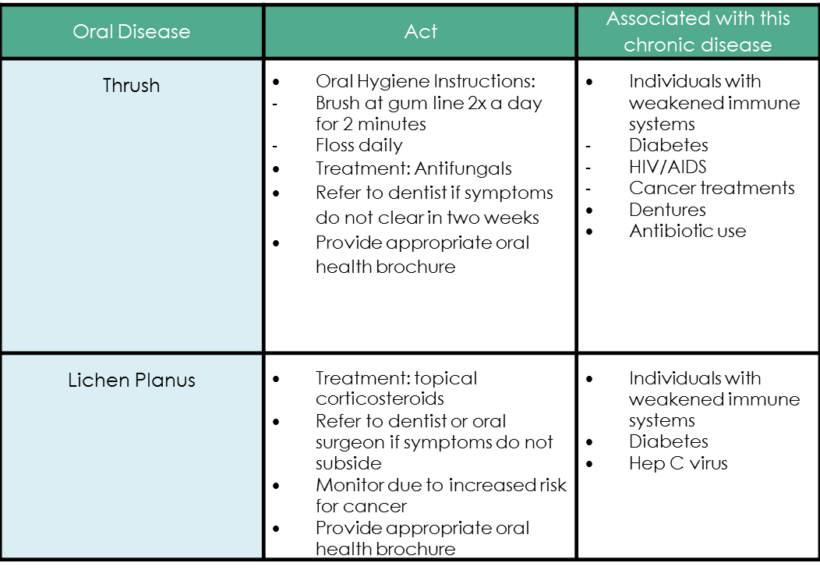
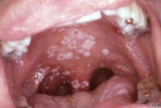
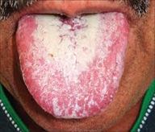
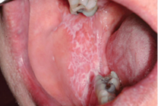
Decide/Act
Oregon Oral Health Coalition, (n.d) Oral Health and Chronic Disease Integration Guide, https://static1.squarespace.com/static/554bd5a0e4b06ed592559a39/t/5994bf77bebafbd3d152a8ce/1502920568547/OHCD+Integration+Guide.pdf
Notes:
Let’s review the activity you just went through and see how you did. (answer any questions they have about the correct answers)

Slide 23
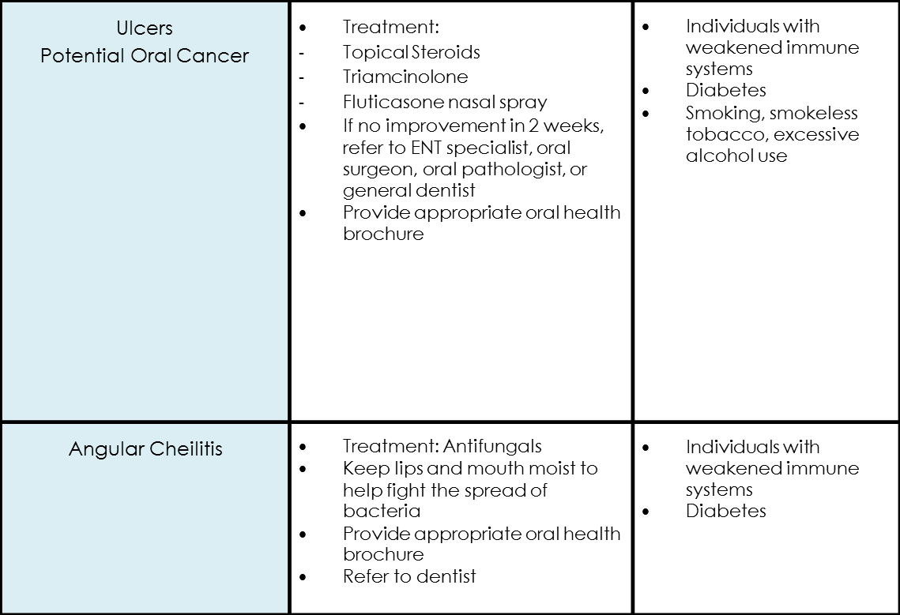
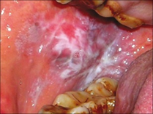
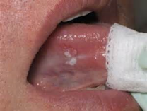
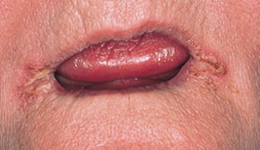
Decide/Act
Oral Disease | Act | Associated with this chronic disease
Oregon Oral Health Coalition, (n.d) Oral Health and Chronic Disease Integration Guide, https://static1.squarespace.com/static/554bd5a0e4b06ed592559a39/t/5994bf77bebafbd3d152a8ce/1502920568547/OHCD+Integration+Guide.pdf
Notes:
Let’s review the activity you just went through and see how you did. (answer any questions they have about the correct answers)

Slide 24
Integration in the PCP office
Oral Health Information for Patients (1 page in English and Spanish)
(will be available in the diabetes binders)
Oral Health Information for Providers (this presentation and resources on SharePoint)
Health Services>Medical>Provider Resources>On Call Tips for Dental Issues
OR
Health Services>Dental>Resources for Medical Providers
Bidirectional Referrals in Epic – to aid with referrals
Notes:
Information for Patients – Kasi has the content and is completing the design to ensure it is perfect. We’ll email you when this is available
Information for Providers – The content is ready but we are waiting for IT to create the page so we can upload the additional information. We will email links when this is complete.
The bidirectional referral workflow is currently in flux since the pilot has exposed some flaws. There is a draft of the workflow and we will post the final workflow as soon as the Lean tools have solved our issues.

Slide 25





Thank You!
@VGMHC
@VGMHCComunidad (Spanish-only page)
@VirginiaGarcia
@VGMHC
Virginia Garcia Memorial Health Center and Foundation
Virginia Garcia Memorial Health Center

